Slide 1
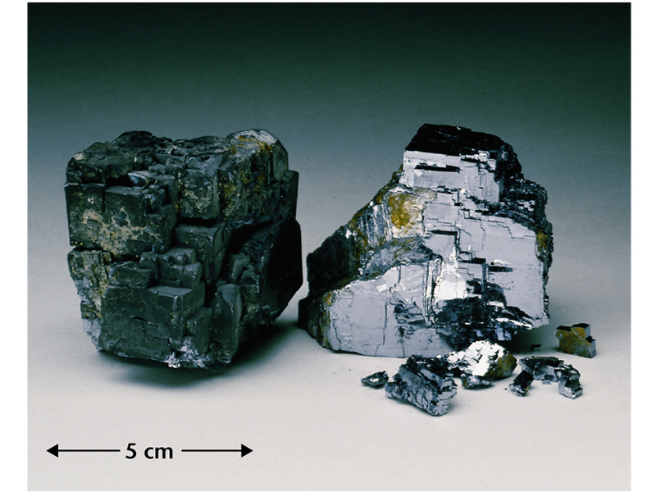
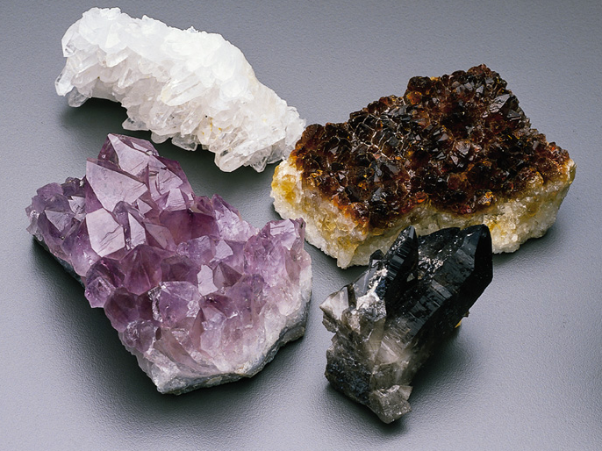
Minerals
November 28, 2011

Slide 2
The earth is made of rocks, which are in turn made of minerals. In this part of the course we'll learn how to identify common minerals and rocks.
In order for something to be classified as a mineral, it must meet five (5) criterion:
Minerals are:
· 1. Naturally occurring,
· 2. Inorganic,
· 3. Have known chemical compositions
· 4. Have definite physical properties.
5. Are solid
·
They are usually (although not always) crystalline.

Slide 3
Physical and Chemical Properties
  Physical properties of matter like color or shape can be observed without changing the identity of the substance.
Chemical properties like flammability or reactions with different substances can only be observed by changing the identity of the substance into something else.

Slide 4
Colour (color)
Color is a physical property that is not very helpful in identifying most minerals for two reasons.
  Many minerals come in a variety of colors like quartz, calcite, or fluorite.
  The colors of minerals can change as a result of exposure to heat, cold or pollution.

Slide 5
Colour of Quartz (SiO2)

Slide 6
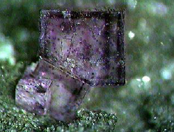
Colour of fluorite (CaF2)

Slide 7
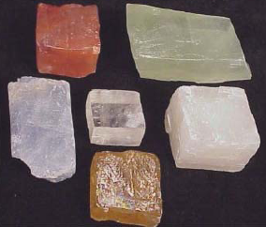
Colour of Calcite (CaCO3)

Slide 8
One coloured minerals
Sulfur is always yellow
Malachite is always green.
Azurite is always a deep blue

Slide 9
Play of colours
Interference of light either at the surface or
In the interior of a mineral may produce a series of colours as the angle of incident light change.
Labradorite and Diamond posses this property

Slide 10
Tarnish
Induced colour when minerals are exposed to air due to oxidation or chemical action of substances in the atmosphere.
Tarnish disappear when the mineral is rubbed on cloth or surface is scratched
Chalcopyrite is yellow but tarnish to iridiscent (mixture of colours)

Slide 11
Luster (lustre)
Luster describe how a mineral shines. It has nothing to do with color or shape. The terms used are generally not scientific, but are meant to be descriptive.
The luster of minerals is divided into two main classes:
METALLIC AND NON-METALLIC

Slide 12
METALLIC LUSTER
  Hematite(an ore of iron)Minerals with a metallic luster have a shine like metals. Galena(an ore of lead)Graphite(used for pencil lead)Pyrite(fools gold)
Graphite
Pyrite
Hematite
Galena

Slide 13
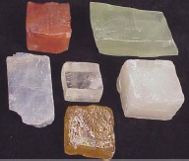
Non-Metallic Lusters
There are many non-metallic lusters. Some more common ones are vitreous (glassy),earthy, and pearly.
Vitreous(commonly called “glassy”) –This is the most common luster. It simply mean the “look of glass.”

Slide 14
Earthy & pearly Luster
Earthy Luster –This luster has no shine. The surface looks like dirt or earth.
Red Hematite–an important ore of iron
  Pearly Luster –shines like a pearl
Talc –the softest mineral. Used for talcum powder and soaps.

Slide 15
Streak
The Property of Streak is closely related to color, but is a different property because the color of the mineral may be different than the color of the streak. Streak is actually the color of the powder of a mineral. It is called streak because the proper way to test for streak is to rub a mineral across a tile of white unglazed porcelain and to examine the color of the "streak" left behind.
Hematite may be black, gray, or red but its streak is always a reddish brown.

Slide 16
How A Mineral Breaks
There are two properties to describe how a mineral breaks, cleavage and fracture.
Cleavage: Cleavage refers to the property that causes a mineral to break or split in one or more directions along smooth flat planes. A mineral may “cleave” along one, two, three, or more different directions.
Fracture: Fracture is the term applied to uneven, irregular or indefinite breaks in minerals. The mineral may break along jagged lines, look splintered or curved like broken glass.

Slide 17
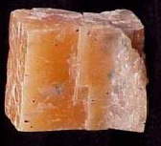
Cleavage
Feldspar
Calcite
Fluorite

Slide 18
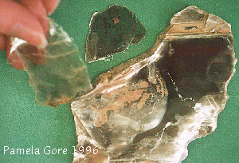
Cleavage in mica

Slide 19
Fracture
All of these minerals have show fracture where they are broken. There are no sides that show a flat smooth plane

Slide 20
Parting
Minerals break along planes of structural weakness. The weakness due to twinning or pressure. Only the affected parts of the crystal show parting

Slide 21
Tenacity
The resistance of a mineral to breaking, crushing, bending or tearing. Its cohesiveness:
Brittle, malleable, sectile, ductile, flexible, elastic

Slide 22
Density
The property of density is probably one of the most useful properties in identifying a mineral. The density of a mineral does not change and no other mineral shares the exact same density. Testing for density is not always possible if you do not want to get the mineral wet by using water displacement to find its volume.

Slide 23
Specific Gravity
Specific gravity
(similar to density)
Weight of a mineral divided by weight of an equal volume of water.
Weight in air/ weight in air-weight in water= Sp.Gr.

Slide 24
Density
Talc’s density = 2.75 g/ml
Galena’s density = 7.57 g/ml
If both minerals are the same size galena will feel much heavier when you pick it up.

Slide 25
Hardness of Minerals
A good property in mineral identification is one that does not vary from specimen to specimen. In terms of reliability, hardness is one of the better physical properties for minerals. Hardness is one measure of the strength of the structure of the mineral relative to the strength of its chemical bonds. In simple terms it is the ability of a mineral to resist being scratched. Minerals with small atoms, packed tightly together tend to be the hardest minerals. Hardness is generally the same for a mineral because the chemistry of any mineral is generally the same. For example, all diamonds are made of carbon atoms that are always joined together in the same pattern. The most valuable minerals, those that are classified as gems, are the hardest minerals. A diamond is the hardest mineral.

Slide 26
Moh’s Hardness Scale
Hardness can be tested through scratching. A scratch on a mineral is actually a groove produced by fractures on the surface of the mineral. A mineral can only be scratched by a harder substance. A hard mineral can scratch a softer mineral, but a soft mineral can not scratch a harder mineral (no matter how hard you try). Therefore, a relative scale can be established to account for the differences in hardness simply by seeing which mineral scratches another. The Mohs Hardness Scale, proposed by French mineralogist Friedrich Mohs, starting with talc at 1 and ending with diamond at 10, is universally used around the world as a way of distinguishing minerals. Simply put; the higher the number, the harder the mineral.
Below is the MOH’S HARDNESS SCALE.
  1.Talc
  2.Gypsum
  3.Calcite
  4.Fluorite
  5.Apatite
  6.Orthoclase(Feldspar)
  7.Quartz
  8.Topaz
  9.Corundum(ruby and sapphire)
  10.Diamond

Slide 27
Hardness
The Field Hardness Scale Most people do not carry minerals with them when they are out in the field identifying minerals, so a field scale is most often used to test hardness. This scale relies on everyday items that a person might have with them.

Slide 28
Hardness

Slide 29
Transparency & Translucency
Outline of objects can be seen through it and are clear and sharp= Transparency
Outlines are blurred and hazy = Translucency
No light is transmitted through the mineral = Opaque

Slide 30
Magnetism
Magnetite (Fe3O4) and Pyrrhotite (FeS) are ferromagnetic- attracted to hand magnet. Paramagnetic = attracted to a powerful electromagnet. Diamagnetic = repelled minerals
Minerals can be separated from each other depending on magnetic characteristics

Slide 31
Electricity
Metallic bonding in native metals=Conductors
Partially metallic bonding in sulphide minerals = Semi-conductors
Ionic or Covalent bonds in minerals = non-conductors. Some minerals conduct by:
Pyrolectric minerals (by temperature)
Piezoelectric minerals (by pressure)

Slide 32
Crystal structure
Crystal structure depends on sizes of and charges on ions
Most common mineral group is the silicates
All silicate minerals contain silicon and oxygen
1. Mafic silicate minerals contain iron or magnesium and are dark in color.
Examples: olivine, pyroxene, amphibole, and biotite mica
2. Felsic silicates don't contain magnesium or iron, and are light in color.
Examples: feldspar, quartz, clay minerals, muscovite mica

Slide 33
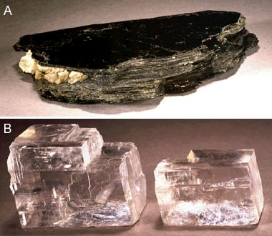
Mafic silicate
Felsic silicate

Slide 34
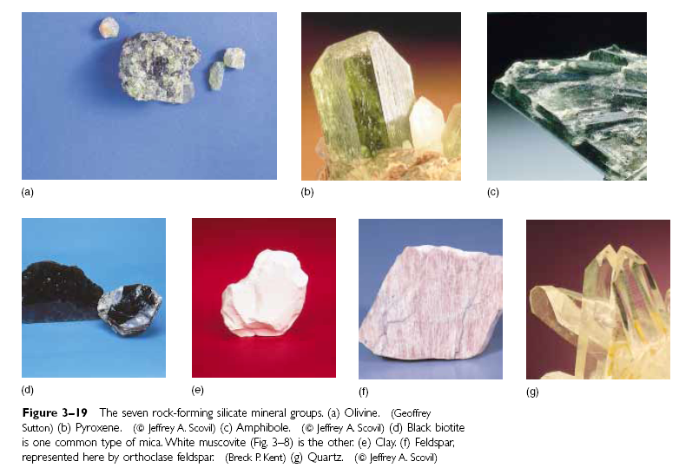

Slide 35
Silicate mineral structures
Basic building block: silica tetrahedron
Silica tetrahedron is a silicon ion bonded to 4 oxygen ions
Silicon is positively charged (+4)
Oxygen is negatively charged (-2)
Net charge on tetrahedron: -4
Because entire tetrahedron is negatively charged, it is attracted to cations
Tetrahedra may link together by a cation (e.g. Mg, Fe, Na, Ca, K) serving as a bridge, or may link together by sharing oxygens

Slide 36
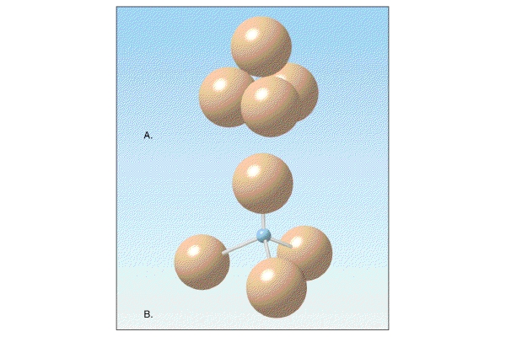
Silica Tetrahedron
Silicon
Oxygens

Slide 37
Isolated tetrahedral structure
Cations serve as links between tetrahedra; no sharing of oxygens
e.g. olivine, and garnet, which also happen to be mafic silicates
Single chain silicates
Adjacent tetrahedra form a chain by sharing 2 of their oxygens with neighboring tetrahedra
e.g. pyroxenes, which also happen to be mafic silicates

Slide 38
Double chain silicates
Two chains can link up by sharing oxygens
e.g. amphiboles, which are mafic silicates too
Sheet silicates
Sheets are formed when each tetrahedron shares 3 of its oxygens with its neighbors
e.g. micas, biotite (mafic) and muscovite (non-mafic), and clay minerals, which are non-mafic silicates
Framework silicates
Every oxygen in each tetrahedron is shared to form 3-D framework
e.g. feldspar, quartz, which are also non-mafic

Slide 39
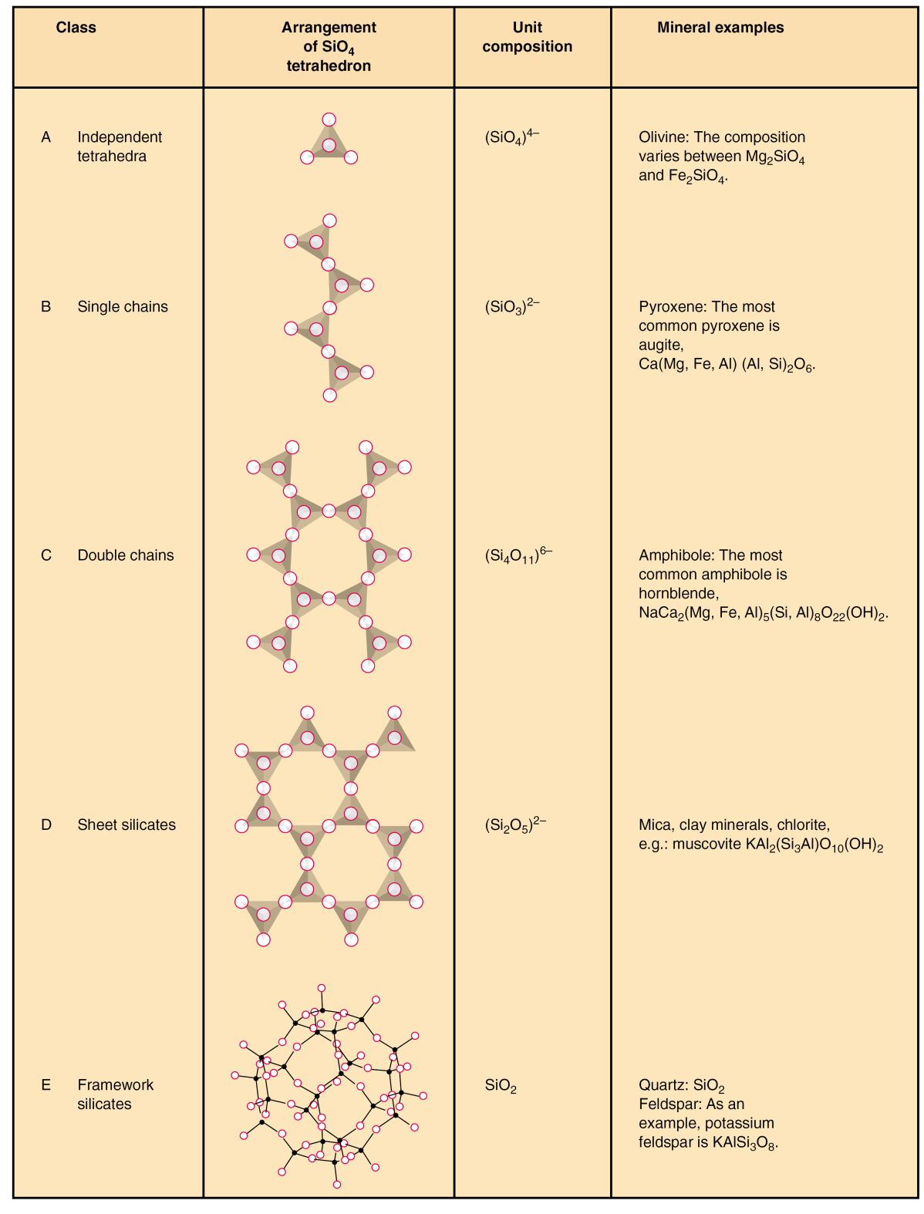

Slide 40
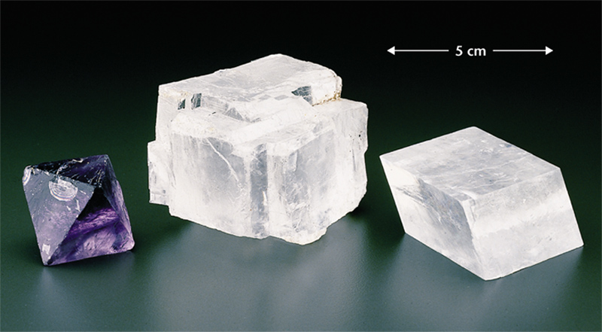
Common non-silicate minerals
Fluorite – used as a toothpaste additive
Calcite -- calcium carbonate -- Limestone is made of calcite.
Dolomite -- calcium magnesium carbonate
Gypsum -- calcium sulfate
Galena -- lead sulfide
Pyrite -- iron sulfide
Halite -- sodium chloride (table salt)

Slide 41
Thanks

