Slide 1
Classification of Minerals
Nearly 4000 minerals have been identified on Earth (most of which we don’t really worry about).
Rock-forming minerals
Common minerals that make up most of the rocks of Earth’s crust
Only a few dozen members
Composed mainly of the 8 elements that make up 98% of the continental crust

Slide 2
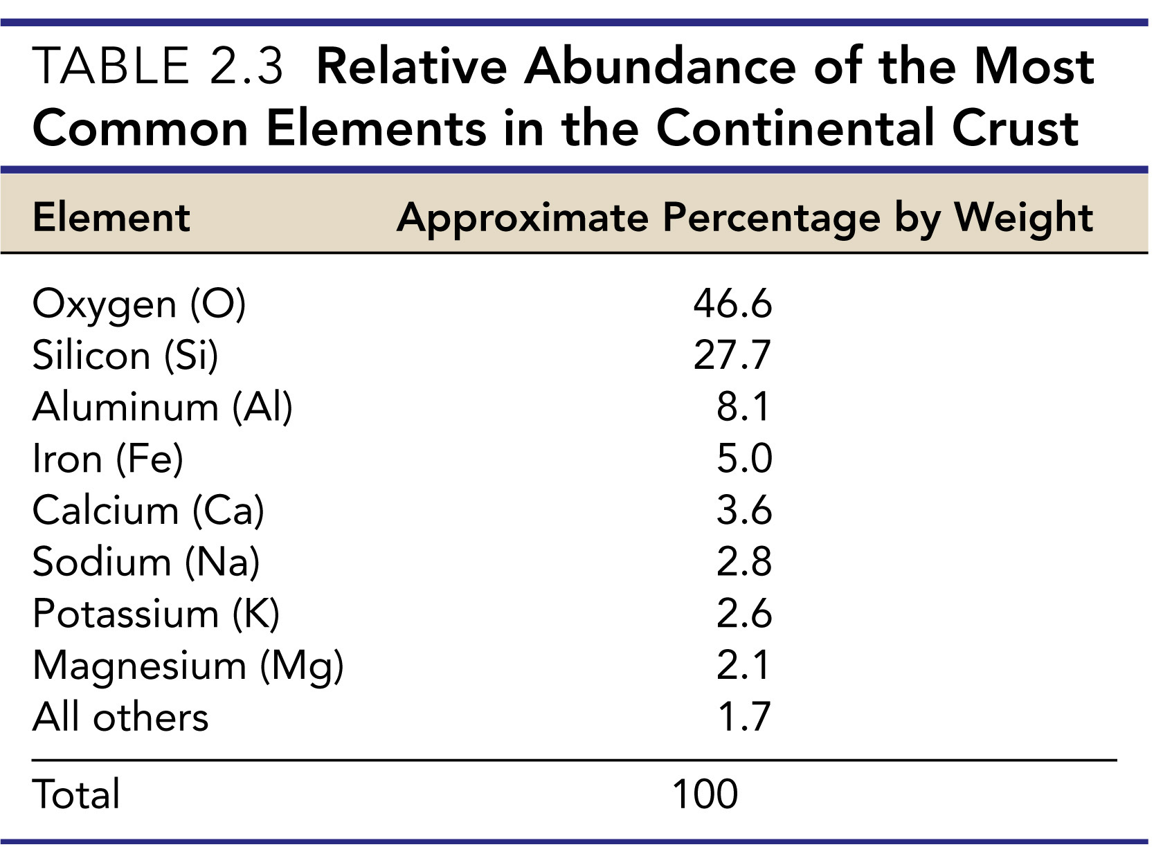

Slide 3
Classification of Minerals
Silicates
Most important mineral group
Comprise most of the rock-forming minerals
Very abundant due to large amounts of silicon and oxygen in Earth’s crust

Slide 4
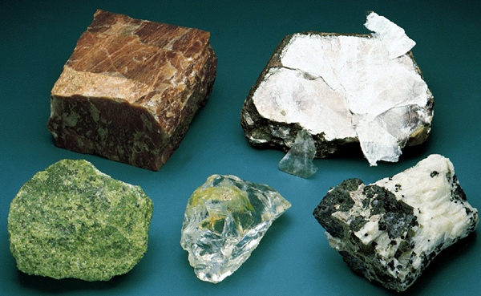
Silicate Mineral Examples
Mica
Feldspar
Olivine
Quartz
Pyroxene

Slide 5
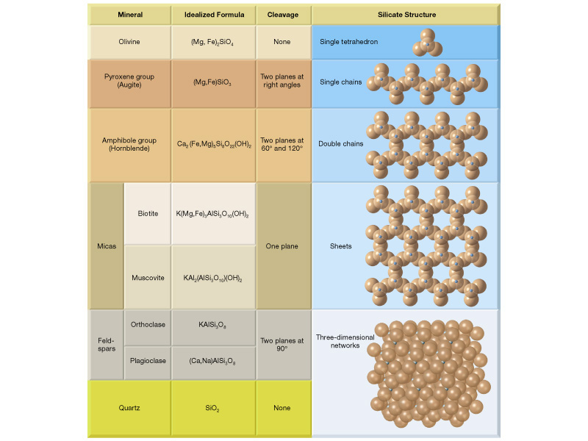

Slide 6
Silicates (SiO₄) ⁻⁴
The most important group of minerals!!
Nesosilicates
Sorosilicates
Cyclosilicates
Inosilicates
Phyllosilicates
Tectosilicates

Slide 7
Why can they form so many structures?
Mesodesmic
Remember this term?

Slide 8
Nesosilicates

Slide 9
Sorosilicates

Slide 10
Cyclosilicates

Slide 11
Inosilicates

Slide 12
Phyllosilicates

Slide 13
Tectosilicates

Slide 14
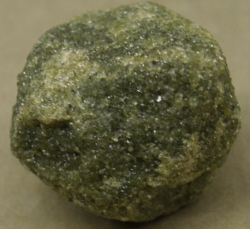
Classification of Minerals
Common Silicate minerals
Olivine
Consists of High temperature Fe-Mg silicate called ferro-magnesian (typical mantle mineral - formed 100’s km in Earth
Individual tetrahedra linked together by iron and magnesium ions
Forms small, rounded crystals with no cleavage
(Mg,Fe)₂SiO₄
First mineral to crystallize out of a basaltic magma

Slide 15
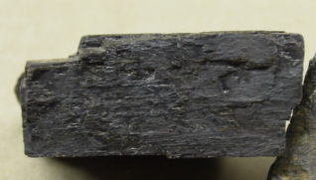
Classification of Minerals
Common Silicate minerals
Pyroxene Group for example (Mg,Fe)SiO₃
Single chain structures involving iron and magnesium,
Chains are weakly paired
Two distinctive cleavages at nearly 90 degrees
Augite is the most common mineral in the pyroxene group

Slide 16
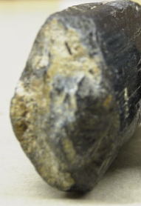
Classification of Minerals
Common Silicate minerals
Amphibole Group Ca₂(Fe,Mg)₅Si₈O₂₂(OH)₂
Double chain structures involving a variety of ions
Two perfect cleavages exhibiting angles of 124 and 56 degrees
Hornblende is the most common mineral in the amphibole group

Slide 17
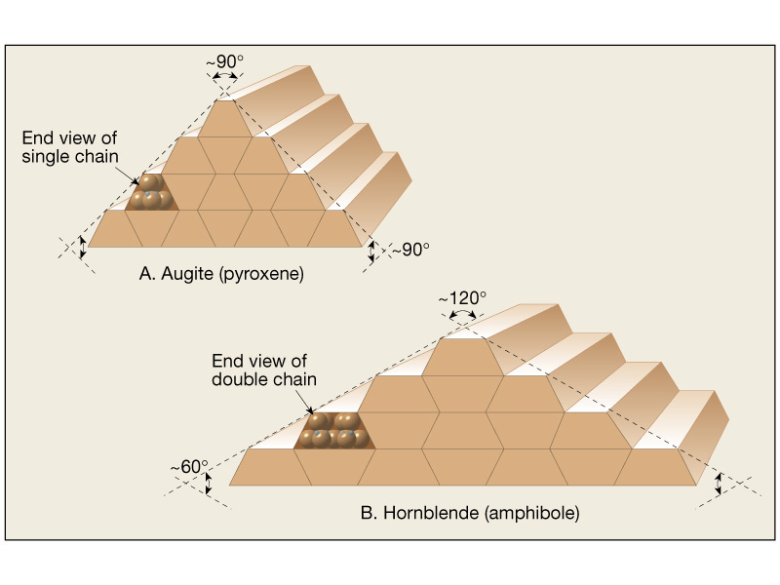
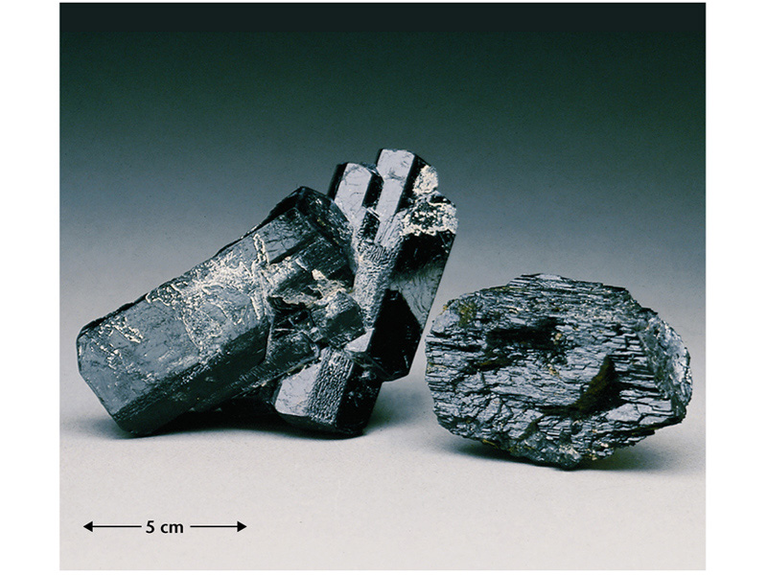
Hornblende Crystal 56 and 124 degree Cleavages
Distinguish Hornblende from
Pyroxene Group by cleavage
Pyroxene Crystal Two Cleavage Faces at about 90 degrees

Slide 18
Classification of Minerals
Common Silicate minerals
Mica Group
Sheet structures that result in one direction of perfect cleavage
Biotite is the common dark colored mica mineral
Muscovite is the common light colored mica mineral

Slide 19
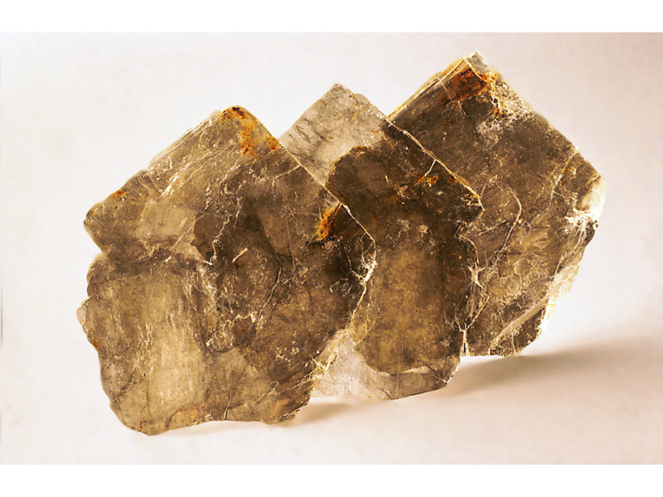
Muscovite
KAl₃Si₃O₁₀(OH)₂

Slide 20
Classification of Minerals
Common Silicate minerals
Feldspar Group
Most common mineral group
3-dimensional framework of tetrahedra exhibit two directions of perfect cleavage at 90 degrees
Orthoclase (potassium feldspar) and Plagioclase (sodium and calcium feldspar) are the two most common members

Slide 21
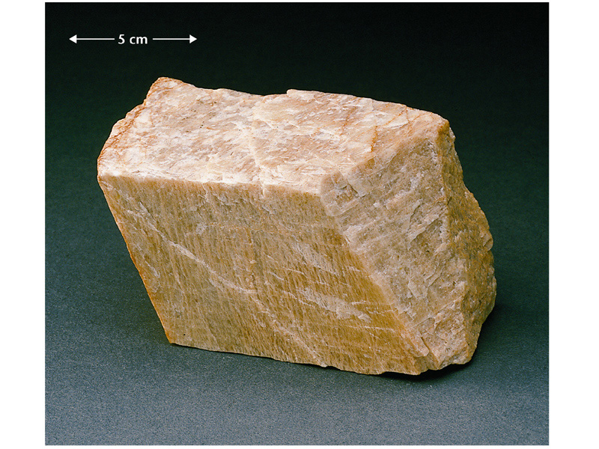
Potassium feldspar
KAlSi₃O₈
Note Pearly Luster!

Slide 22
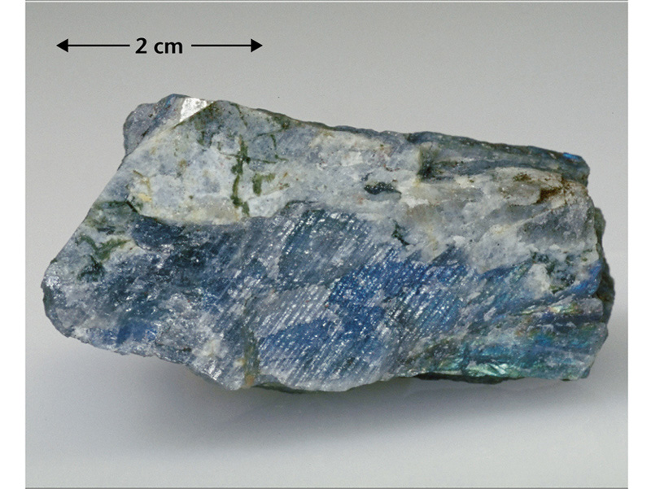
Plagioclase feldspar
(Ca,Na)AlSi₃O₈
Note the Twinning, seems to have ‘stripes’

Slide 23
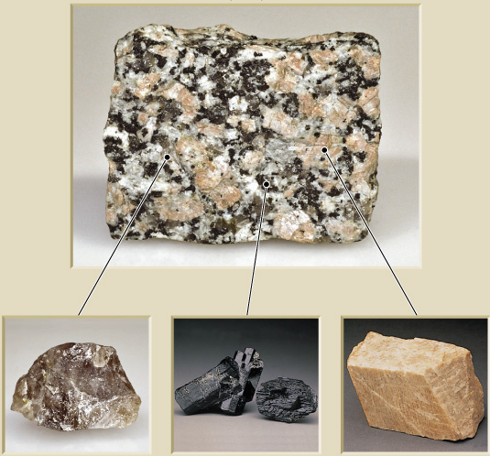
Minerals in Granite Rock: What is the pink stuff?

Slide 24
Classification of Minerals
Common Silicate minerals
Clay minerals
Clay is a general term used to describe a variety of complex minerals
Clay minerals all have a sheet or layered structure
Most originate as products of chemical weathering

Slide 25
Classification of Minerals
Important nonsilicate minerals
Several major groups exist including
Oxides
Sulfides
Sulfates
Native Elements
Carbonates
Halides
Phosphates

Slide 26
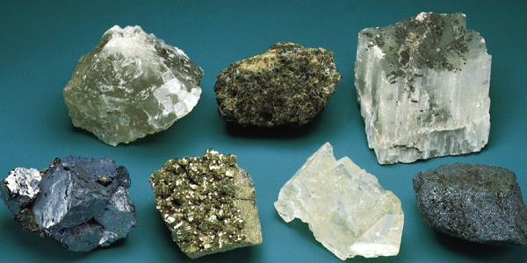
Nonsilicate Mineral Examples
Spinel
(Oxide)
Halite
(Halide)
Gypsum
(Sulfate)
Hematite
(Oxide)
Calcite
(Carbonate)
Pyrite
(Sulfide)
Galena
(Sulfide)

Slide 27
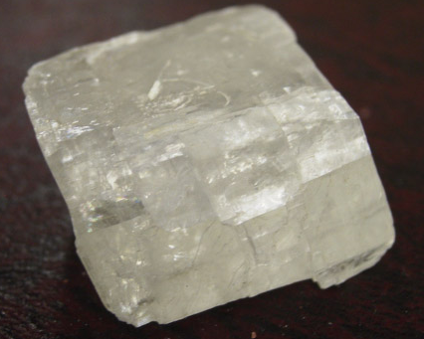
Classification of Minerals
Important non-silicate minerals
Carbonates contain CO₃^{= fizzing with acid}
Primary constituents in limestone and dolostone
Calcite (calcium carbonate) and Dolomite (calcium-magnesium carbonate) are the two most important carbonate minerals
Calcite showing cleavage faces

Slide 28
Classification of Minerals
Important nonsilicate minerals
Many nonsilicate minerals have economic value
Examples
Hematite (oxide mined for iron ore)
Halite (halide mined for salt)
Sphalerite (sulfide mined for zinc ore)
Native Copper (native element mined for copper)

Slide 29
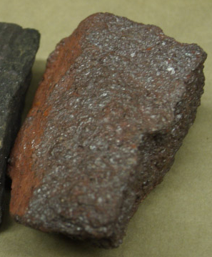
Hematite, an oxide, Fe₂O₃
An important Iron ore. Very high density

Slide 30
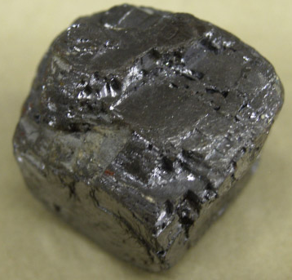
Galena, PbS, a Sulfide
An important ore of Lead

Slide 31
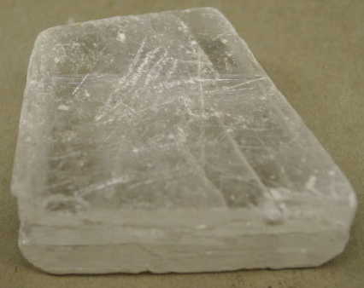
Gypsum, a Sulfate CaSO₄.2H₂O
An important evaporite mineral, used to make sheetrock =drywall

Slide 32
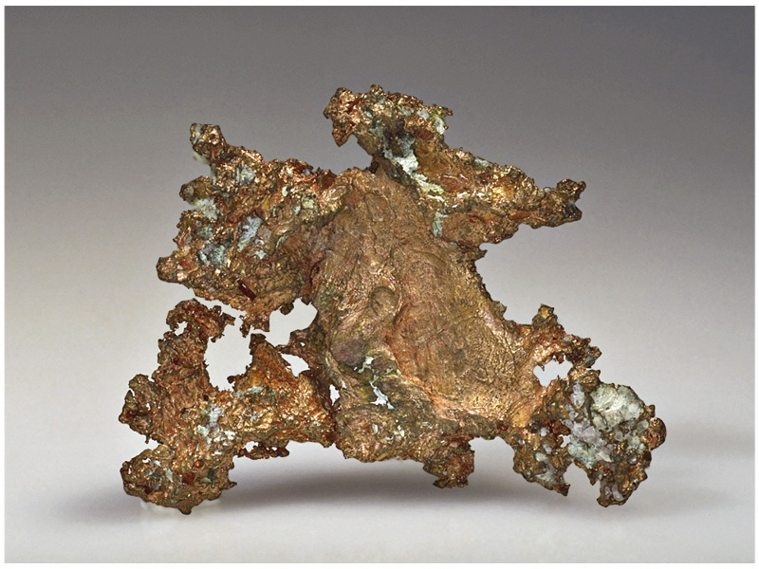
Native Minerals – Copper A pure element

Slide 33
That’s all

