Slide 1
SILICATES

Slide 2
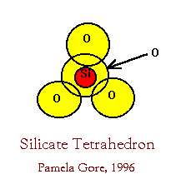
Silicon-oxygen tetrahedron

Slide 3
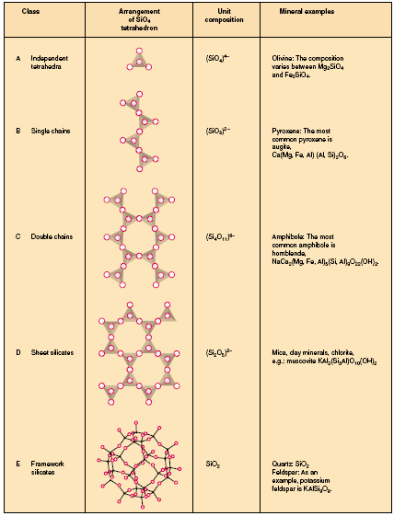
Silicates

Slide 4
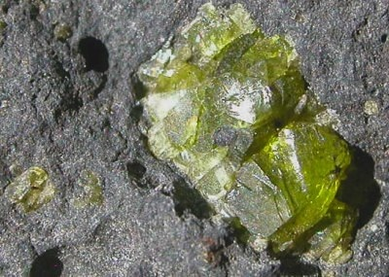
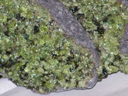
Nesosilicates
Olivine (Mg,Fe)2SiO4

Slide 5
Olivine (Mg,Fe)2SiO4
Orthorhombic,
Olive green (forsterite ‘Mg’), brown (fayalite ‘Fe’),
streak colourless,
vitreous,
transparent to translucent,
no cleavage, conchoidal,
H. 7, sp.Gr. 3.2-4.3
In mafic & ultramafic rocks ‘peridot in some, also in marbles
Gem & as refractory for casting industry

Slide 6
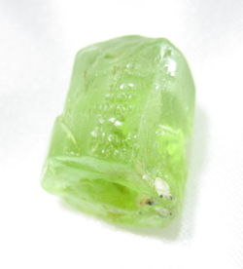
Peridot
Gem quality of olivine (forsterite) occurs at St. John’s Island near Ras Benas in the Red Sea.
Highly valued in Gem markets

Slide 7
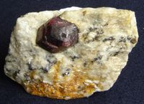
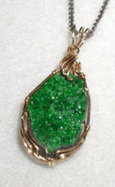
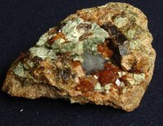
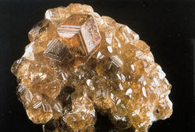
Nesosilicates
Garnet R++3 R+++2 (SiO4)3

Slide 8
Garnet
Cubic, usually rhombdodecahedrons & also massive,
red,brown, yellow, green, black,
streak white, vitreous to resinous, transparent to translucent, no cleavage, uneven to conchoidal,
H.7, Sp.Gr. Av.4
In metamorphic rocks, alakline igneous rocks and in placers
Sri Lanka, India, Brazil
Abrasive, cheap gemstone

Slide 9
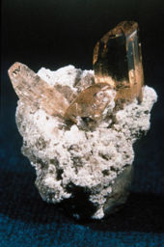
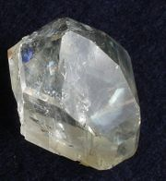
Topaz Al2SiO4 (F,OH)

Slide 10
Topaz
Orthorhombic,
basal cleavage & should be handled with care,
straw yellow but may have other colours,
vitreous,
transparent to translucent,
cochoidal to uneven,
H. 8, Sp. Gr. 3.5
USA, Afghanistan, Sri Lanka
Gem mineral

Slide 11
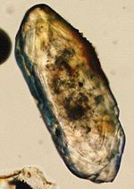
Zircon ZrSiO4

Slide 12
Zircon ZrSiO4
Tetragonal,
Colourless (highly valued as substitute for diamond), & other colours,
streak white,
indistinct cleavage,
transparent,
H. 7.5, Sp.Gr. 4.6,
radioactive
Russia, Italy, Norway
In granites and clastic sediments
In abrasives and insulating material, ZrO2 is refractory.

Slide 13
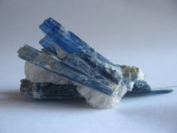
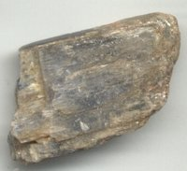
Kyanite Al2SiO5

Slide 14
Kyanite
Triclinic,
blue darker in the centre,
Streak white, pearly
transparent to translucent,
perfect 100 cleavage,
uneven,
H. 5 (parallel to length) & 7 , Sp.Gr. 3.6
In metamorphic rocks
Switzerland, Austria, Kenya
Spark plugs & refractory porcelain

Slide 15
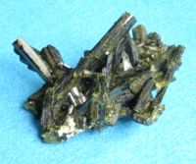
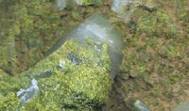
Sorosilicates
Epidote (Silicates of Ca, Al & Fe)

Slide 16
Epidote
Monoclinic, massive & acicular,
pistachio-green to yellowish green,
streak white,
vitreous,
transparent to translucent,
perfect cleavage,
uneven,
H. 7, Sp.Gr. 3.3
In metamorphic rocks, in veins & joints
Austria, france
No economic use but the Ce variety allanite is ore of Cerium 7 rare earths

Slide 17
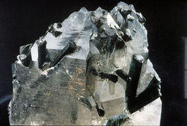
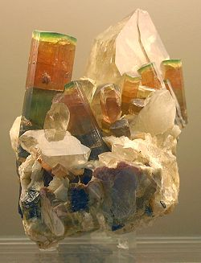
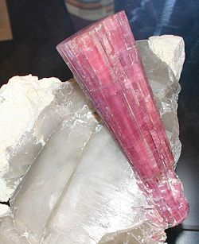
Cyclosilicates
Tourmaline (Complex borosilicate = Al, Na, Li, Mg, Fe)

Slide 18
Tourmaline
Trigonal, striated, radiating needles or massive, granular,
brown to black
streak colourless,
vitreous,
trasparent to opaque,
no cleavage, conchoidal,
H. 7.5, Sp.Gr. 3
In granites, pegmatites 7 metamorphic R.
Brazil, Russia, USA
Semi-precious gem, pressure gauge (due to its piezoelectric property)

Slide 19
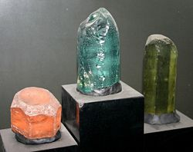

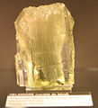
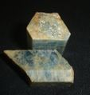
Cyclosilicates
Beryl Be3Al2(Si6O18)

Slide 20
Beryl
Hexagonal, striated,
yellow or white but blue is aquamarine,deep green is emerald,
Streak white,
vitreous,
transparent to translucent,
no cleavage, conchoidal,
H. 7.5, Sp.Gr. 2.7
In granites & metamorphic rocks
India, Brazil, Sudan, in Wadi Gemal (ED)
As Gem ‘emerald’, Be in alloys

Slide 21
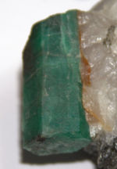
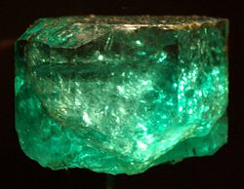
Emerald
Beryl with Cr and V impurities

Slide 22
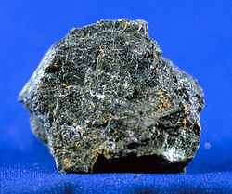
Inosilicates
Pyroxene (Single Chain)
Augite

Slide 23
Pyroxene
Augite
Monoclinic in prismatic xls, with square or 8 sided cross section,
black to greenish black,
streak white,
vitreous transparent to translucent,
2 sets of 90º cleavage,
H. 6, Sp.Gr. 3.2
A rock forming mineral in mafic, ultramafic igneous rocks & in metamorphic rocks
No economic use

Slide 24
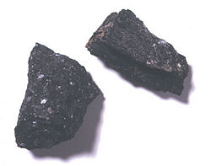
Inosilicates
Amphibole (Double Chain)

Slide 25
Amphibole
Hornblende
The mineral is Similar to augite but cross section is 6-sided, cleavages meet at 120o

Slide 26
Phyllosilicates
The Serpentine Group
The mica Group
Clay mineral Group
Chlorite Group

Slide 27
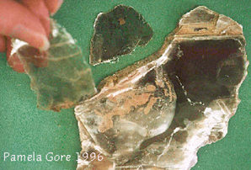
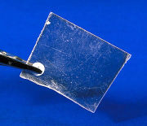
Mica Group
Muscovite

Slide 28
Muscovite
Monoclinic, tabular, foliated, large sheets. White brown & green, streak colourless, vitreous to pearly transparent to translucent, 001 cleavage, elsatic, H/ 2.5, Sp. Gr. 2.8
Rock forming mineral
India, Canada, Rd Ishab (E.D.)
Insulating material, Isinglass for furnace and stove doors, wallpaper, a filler for fireproofing
Material, lubricant when mixed with oil

Slide 29
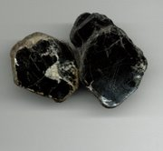
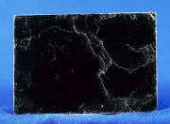
Mica Group
Biotite (Silicates of Mg, Fe, Al, K + OH)

Slide 30
Biotite
Monoclinic irregular foliated masses or scales, dark green, brown to black, transparent to opaque, perfect 001 cleavage, flexible & elastic, H.3,Sp.Gr.3
In most igneous and metamorphic rocks
No economic use

Slide 31
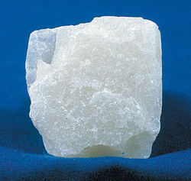
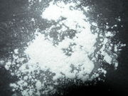
Mica Group
Talc Hydrous Mg Silicate

Slide 32
Talc
Monoclinic, foliated or radiated, when massive it is soapstone or steatite
Apple green, grey & white, streak white, pearly to greasy, translucent, 001 perfect cleavage, folia flexible, H.1, Sp.Gr. 2.7
In metamorphic rocks, in altered U-mafics.
USA, Austria, Germany,
Hamata, Derhib (E.D.), south Aswan

Slide 33
Talc
Slabs of steatite are used in electric switchboards and laboratory table tops,
Powdered talc in paint, ceramics, insecticides, paper, etc.
The most familiar used is in talcum powder, taking into consideration the absence of acicular minerals (carcinogenic)

Slide 34
Tectosilicates
Feldspar Group
Feldspathopoid Group
SiO2 Group
Scapolite Group
Zeoliyre Group

Slide 35
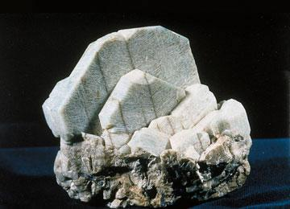
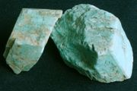
Potash Feldspars
Microcline (K Al Silicate)

Slide 36
Microcline
Triclinic, usually twinned xls, 2000 ton xl is known from Russia, white, pale yellow & green, vitreous transparent to translucent, perfect cleavage, H. 6.5, Sp.Gr. 2.5
In granites
Russia, Norway, USA
In porcelain, glass. Amazonstone (deep green) is an ornamental stone

Slide 37
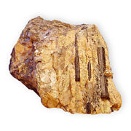
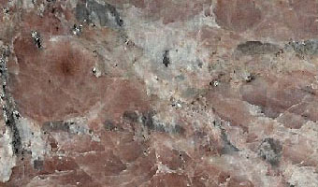
Potash Feldspars
Orthoclase (K Al Silicate)

Slide 38
Orthoclase
Monoclinic, short twinned xls, massive, white to flesh red, streak white, vitreous to pearly, transparent to translucent, perfect cleavage, uneven, H.6, Sp.Gr. 2.5
Granites, veins & in some sandstones
In porcelain and glass industries

Slide 39
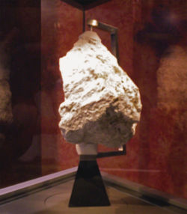
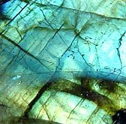
Plagioclase Feldspars
Albite (NaAlSi3O8)
Oligoclase
Andesine labradorite
Bytownite
Anorthite (CaAl2Si2O8)

Slide 40
Plagioclase Feldspars
Triclinic, tabular, twinned striated xls, white, grey & yellowish, streak white, vitreous to pearly, transparent to translucent, perfect cleavage, H. 6, Sp.Gr. 2.6 for Albite (Na) & 2.7 for anorthite (Ca)
In igneous and metamorphic rocks
Albite used in ceramics, labradorite (Ca-Na) ornamental stone due to play of colour, Moonstone (albite) is semi-gem

Slide 41
The SiO2 Group
Quartz SiO2

Slide 42
Quartz
Trigonal, prismatic striated, massive, granular, colourless to white. Coloured varieties include; amethyst (purple), smoky (black), Rose (rose red), milky (milky white0, streak colourless, vitreous, transparent to translucent, no cleavage, conchoidal, H. 7, Sp.Gr. 2.65
A very common mineral
Large xls from Brazil, Japan, Madagascar

Slide 43
Quartz
Amethyst & rosy quartz are gems
Qz is used in optical and electrical equipments
Sand is used in mortar, concrete, glass, abrasives and porcelain
A flux in smelting operations
Production of ferro-silicon used in steelmaking and foundaries

Slide 44
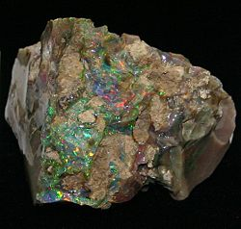
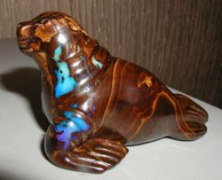
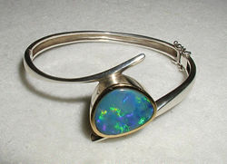
Opal
Hydrous silica-SiO2.nH2O

Slide 45
Opal
Water =10% generally amorphous , massive, botryoidal, colourless, white, milky slightly coloured, play of colour, streak white, sub-vitreous to resinous, transparent to translucent, conchoidal, H. 6, Sp. Gr. 2.1
Hot sprng deposits, in cavities and replacing wood, in geodes
Hungary, Australia, USA
As gem shaped in rounded form known as
Cabochon

Slide 46
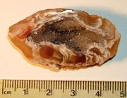
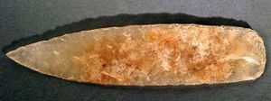
Chalcedony
Cryptocrystalline silica

Slide 47
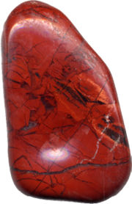
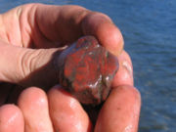
Jasper
Silica with hematite impurities
Cryptocrystalline silica

