Slide 1
THE ENVIRONMENT OF ELECTRONIC COMMERCE: LEGAL, ETHICAL, AND TAX
ISSUES
Aemro B.

Slide 2
L E A R N I N G O B J E C T I V E S
In this chapter, you will learn about:
Laws that govern electronic commerce activities
Laws that govern the use of intellectual property by online businesses
Online crime, terrorism, and warfare
Ethics issues that arise for companies conducting electronic commerce
Conflicts between companies’ desire to collect and use data about their
customers and the privacy rights of those customers
Taxes that are levied on electronic commerce activities

Slide 3
The Legal Environment of Electronic Commerce
Online businesses:
  Must comply with the same international law laws and regulations that govern the operations of all businesses
  Face factors that change the dynamics of operations and competition
    The Web extends a company’s reach beyond traditional boundaries
    The Web increases the speed and efficiency of business communications
    The Web creates a network of customers

Slide 4
Borders and Jurisdiction
Territorial borders in the physical world mark the …
  Range and type of cultural influence
  Reach and jurisdiction of applicable laws
For example, the European Union (EU)…
  Allows free movement within the EU for citizens of member countries and adopted a common currency
  But, there are differences within each member country that differentiate each state from another based on
    Culture
    Laws
    Ethical Attitudes

Slide 5
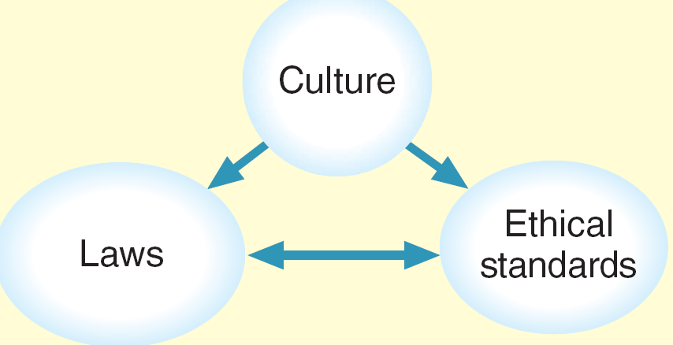
Culture helps determine laws and ethical standards

Slide 6
T H E L E G A L E N V I R O N M E N T O F
E L E C T R O N I C C O M M E R C E
Borders and Jurisdiction
Legal scholars define the relationship between geographic boundaries and legal boundaries in terms of four elements
  power
  effects
  legitimacy
  notice

Slide 7
Jurisdiction on the Internet
Defining, establishing, and asserting jurisdiction are much more difficult on the Internet than they are in the physical world,
  Conflict of Laws
  Un-bounded transactions

Slide 8
Contracting and Contract Enforcement in Electronic Commerce
Contracts include three essential elements
  Offer: Commitment with certain terms made to another party
  Acceptance: An expression of willingness to take an offer
  Consideration: An agreed upon exchange of something valuable
Written Contracts on the Web
  contracts are valid even if they are not in writing or signed.
  Implied contract: Formed by two or more parties that act as if a contract exists even if no explicit contract exists

Slide 9
Contracting and Contract Enforcement in Electronic Commerce
Statute of Frauds
  The following must be created by a signed writing
    Contracts for the sale of goods worth for bigger transactions
    Contracts requiring actions that cannot be completed within one year
  A writing exists when the terms of a contract have been reduced to some tangible form
  Signature consists of any symbol executed or adopted for the purpose of authenticating a writing

Slide 10
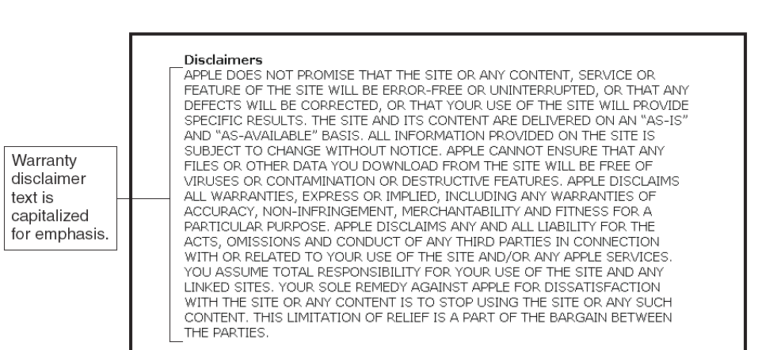
Warranties on the Web
Any contract for the sale of goods includes implied warranties.

Slide 11
Contracting and Contract Enforcement in Electronic Commerce
Warranties: Any contract for the sale of goods includes implied warranties
  The seller warrants that the goods it offers are fit for the purposes for which they are normally used.
Explicit Warranties: A specific statement or description of the warrant terms

Slide 12
Contracting and Contract Enforcement in Electronic Commerce
Warranty disclaimer
  Statement declaring that the seller will not honor some or all implied warranties
Authority to bind
  Determining whether an individual has the authority to commit a company to an online contract
Terms of service (ToS)
  Intended to limit a Web site owner’s liability

Slide 13
Use and Protection of Intellectual Property in Online Business:
Web Site Content Issues
Defamation
  A defamatory statement is a statement that is false and that injures the reputation of another person or company.
  If the statement injures the reputation of a product or service instead of a person, it is called product disparagement.
  commercial Web sites should avoid making negative, evaluative statements about other persons or products.

Slide 14
Web Site Content Issues
Copyright: A right granted by a government to an author or creator of a literary or artistic work
  Creations that can be copyrighted include all forms of artistic or intellectual expression
  Works copyrighted by corporations or not-for-profit organizations are protected for 95 years
How is something copyrighted? One way is to register it; the second is to place a copyright mark on the work ©

Slide 15
Web Site Content Issues
Fair use of a copyrighted work
  Includes copying it for use in criticism, comment, news reporting, teaching, or research
Vicarious copyright infringement
  Entity becomes liable if:
    It is capable of supervising infringing activity
    It obtains financial benefit from infringing activity

Slide 16
Trademark Infringement
Trademark: A distinctive mark, device, motto, or implement that a company affixes to goods it produces ®
Service mark: Used to identify services provided
Trade name: Name that a business uses to identify itself

Slide 17
Patent Infringement
Patents: Exclusive right granted by a government to an individual to make, use, and sell an invention
  To be patentable the invention must be genuine, novel, useful, and not obvious, given the current state of technology
Business process patents Protect a specific set of procedures for conducting a particular business activity
  Name your own price (priceline.com)

Slide 18
Protecting Intellectual Property Online
Intellectual property
  Includes all products of the human mind
  Products can be tangible or intangible
Intellectual property rights
  Include protections by governments through:
    Granting of copyrights and patents
    Registration of trademarks and service marks
digital watermark.
  a digital code or stream embedded undetectably in a digital image or audio file.

Slide 19
Domain Names, Cybersquatting, and Name Stealing
Cybersquatting
  Registering a domain name that is the trademark of a person or company and hoping to sell it to that person or company for money
Name changing
  Registering misspelled variations of well-known domain names
Name stealing
  Ownership of a site’s assigned domain name is fraudulently changed to another site and owner

Slide 20
Domain Names, Cybersquatting, and Name Stealing (continued)
U.S. Anticybersquatting Consumer Protection Act
  Protects trademarked names from being registered as domain names by other parties
  Parties found guilty of cybersquatting can be held liable for damages of up to $100,000 per trademark

Slide 21
Advertising Regulation
AnyWeb site that plans to deal in these products should consult with an attorney who is familiar with the relevant laws before posting any online advertising for such products.
  In some countries may not allow
    Food and Drug Administration (FDA), the Bureau of Alcohol, Tobacco, and Firearms …etc.

Slide 22
OnlineWarfare and Terrorism
Online crime: theft, stalking, gambling, pornography (obscenity), computer commandeering
  Obstacles faced by law enforcement:
    Jurisdiction
    Difficulty applying laws written before the Internet became prone to criminal actions
Online warfare and terrorism
  Sustained effort by a well-financed terrorist group designed to slow down operation of major nodes, routers, and transaction-processing centers
      This includes Web sites that contain detailed instructions for creating biological weapons and other poisons, discussion boards that help terrorist groups recruit new members online, and sites that offer downloadable terrorist training films

Slide 23
Ethical Issues
Ethical issues are often overlooked but they are extremely important to consider when making policy decisions
Differences in cultures throughout the world have resulted in different expectations about privacy in electronic commerce
  Amazon and publishers
  Google in China
    Don’t be evil!
  eBay and guns

Slide 24
E T H I C A L I S S U E S
the damaged reputation and long-term loss of trust that can result in loss of business.
advertising or promotion on the Web should include only true statements and should not omit any information that could mislead potential purchasers or wrongly influence their impressions of a product or service

Slide 25
Privacy Rights and Obligations
The Electronic Communications Privacy Act of 1986 is the main law governing privacy on the Internet today.
Recommended Principles for handling customer data
  Use the data collected to provide improved customer service.
  Do not share customer data with others outside your company without the customer’s permission.
  Tell customers what data you are collecting and what you are doing with it.
  Give customers the right to have you delete any of the data you have collected about them.

Slide 26
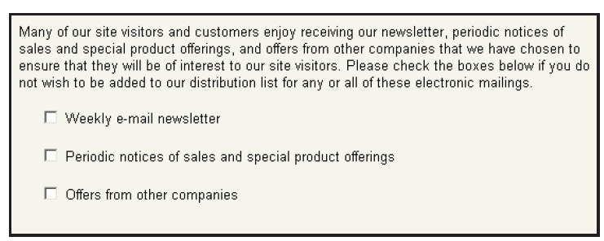
Privacy Rights and Obligations

Slide 27
Communications with Children
Adults who interact with Web sites can read privacy statements and make informed decisions
For more legal issues
  Children’s Online Privacy Protection Act of 1998 (COPPA)
Children’s Internet Protection Act (CIPA)
  Requires schools that receive federal funds to install filtering software on computers

Slide 28
TA X AT I O N
A N D E L E C T R O N I C C O M M E R C E
Traditional businesses may operate in one location and be subject to only one set of tax laws for years
Firms that engage in electronic commerce must comply with multiple tax laws from their first day of existence.
An online business can become subject to several types of taxes, including income
taxes, transaction taxes, and property taxes.

Slide 29
Taxation Dilemmas
Who gets to tax what?
Should there be taxes paid on items bought and sold on the Internet?
Who gets taxes when international sales are made
What is the basis for an Internet tax?

Slide 30
TA X AT I O N
A N D E L E C T R O N I C C O M M E R C E
Income taxes are levied by national, state, and local governments on the net income generated by business activities.
Transaction taxes, which include sales taxes, use taxes, excise taxes, and customs duties, are levied on the products or services that the company sells or uses.
Customs duties are taxes levied by countries when they are imported into the country(on certain commodities )

Slide 31
European Union (EU) Value Added Taxes
Value Added Tax
  Most common transfer tax used in the EU
  Assessed on the amount of value added at each stage of production
EU enacted legislation
  Companies based in EU countries must collect VAT on digital goods

Slide 32
Summary
Legal concept of jurisdiction on the Internet is still unclear and ill defined
Relationship between geographic boundaries and legal boundaries are based on power, effects, legitimacy, and notice
Innocent inclusion of photographs and other elements on a Web page can lead to infringement of trademarks, copyrights, or patents

Slide 33
Summary
The Internet can be used to perpetrate crimes, advocate terrorism, and wage war
Web business practices have led to questions of ethics regarding online privacy
Companies that conduct electronic commerce are subject to the same laws and taxes as other companies
The international nature of business complicates tax obligations

