Slide 1
E-commerce
Aemro B.

Slide 2
Learning Objectives
Understand the scope of e-commerce crime and security problems
Describe the key dimensions of e-commerce security
Understand the tension between security and other values
Identify the key security threats in the e-commerce environment
Describe how various forms of encryption technology help protect the security of messages sent over the Internet
Identify the tools used to establish secure Internet communications channels
Identify the tools used to protect networks, servers, and clients
Appreciate the importance of policies, procedures, and laws in creating security

Slide 3
The Merchant Pays
Many security procedures that credit card companies rely on are not applicable in online environment
As a result, credit card companies have shifted most of the risks associated with e-commerce credit card transactions to merchant
To protect themselves, merchants can:
  Refuse to process overseas purchases
  Insist that credit card and shipping address match
  Require users to input 3 to 5digit security code printed on back of card
  Use anti-fraud software

Slide 4
The E-commerce Security Environment: The Scope of the Problem
2002 Computer Security Institute survey of 503 security personnel in U.S. corporations and government
  80% of respondents had detected breaches of computer security within last 12 months and suffered financial loss as a result
  Only 44% were willing or able to quantify loss, which totaled $456 million in aggregate
  40% reported attacks from outside the organization
  40% experienced denial of service attacks
  85% detected virus attacks

Slide 5
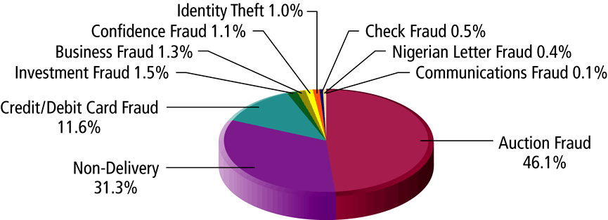
Internet Fraud Complaints Reported to the IFCC

Slide 6
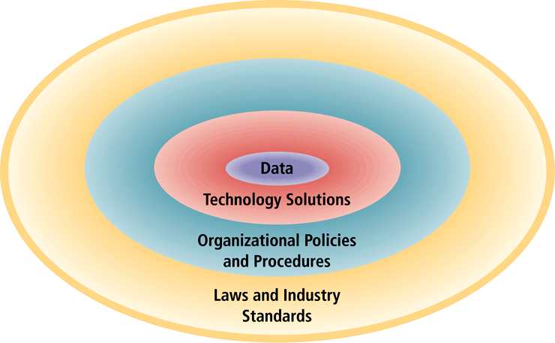
The E-commerce Security Environment

Slide 7
Dimensions of E-commerce Security
Integrity: ability to ensure that information being displayed on a Web site or transmitted/received over the Internet has not been altered in any way by an unauthorized party
Non-repudiation: ability to ensure that e-commerce participants do not deny (repudiate) online actions
Authenticity: ability to identify the identity of a person or entity with whom you are dealing on the Internet
Confidentiality: ability to ensure that messages and data are available only to those authorized to view them
Privacy: ability to control use of information a customer provides about himself or herself to merchant
Availability: ability to ensure that an e-commerce site continues to function as intended

Slide 8
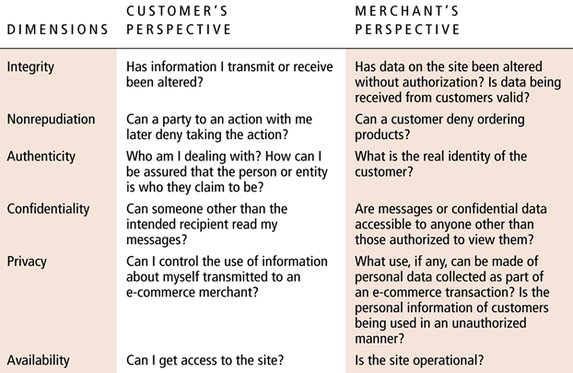
Customer and Merchant Perspectives on the Different Dimensions of E-commerce Security

Slide 9
The Tension Between Security and Other Values
Security vs. ease of use: the more security measures that are added, the more difficult a site is to use, and the slower it becomes
Security vs. desire: of individuals to act anonymously

Slide 10
Security Threats in the E-commerce Environment
Three key points of vulnerability:
  Client
  Server
  Communications channel
Most common threats:
  Malicious code
  Hacking and cybervandalism
  Credit card fraud/theft
  Spoofing
  Denial of service attacks
  Sniffing
  Insider jobs

Slide 11
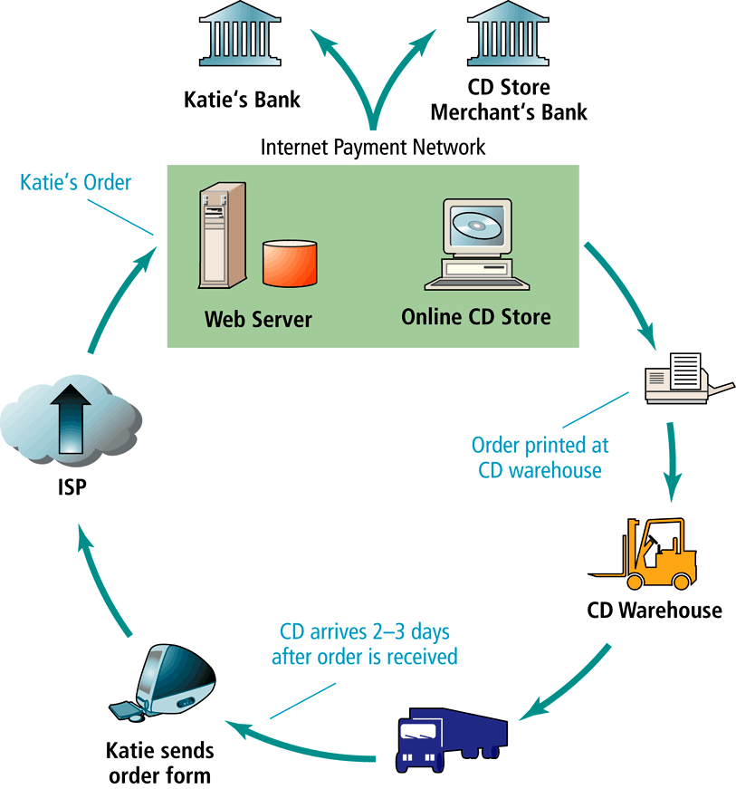
A Typical E-commerce Transaction

Slide 12
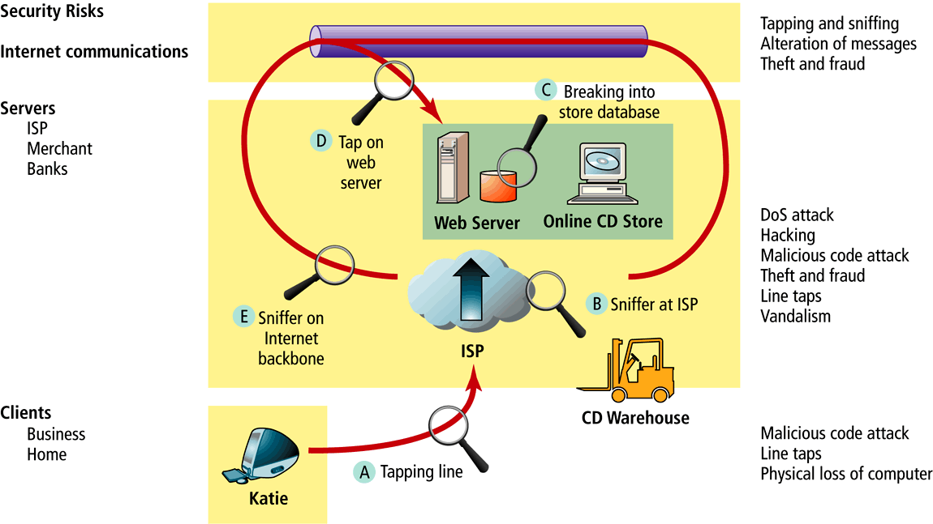
Vulnerable Points in an E-commerce Environment

Slide 13
Malicious Code
Viruses: computer program that as ability to replicate and spread to other files; most also deliver a “payload” of some sort (may be destructive or benign); include macro viruses, file-infecting viruses and script viruses
Worms: designed to spread from computer to computer
Trojan horse: appears to be interesting application, but then does something other than expected
Bad applets (malicious mobile code): malicious Java applets or ActiveX controls that may be downloaded onto client and activated merely by surfing to a Web site

Slide 14
Hacking and Cybervandalism
Hacker: Individual who intends to gain unauthorized access to a computer systems
Cracker: Used to denote hacker with criminal intent (two terms often used interchangeably)
Cybervandalism: Intentionally disrupting, defacing or destroying a Web site
Types of hackers include:
  White hats – Members of “tiger teams” used by corporate security departments to test their own security measures
  Black hats – Act with the intention of causing harm
  Grey hats – Believe they are pursuing some greater good by breaking in and revealing system flaws

Slide 15
Credit Card Fraud
Fear that credit card information will be stolen deters online purchases
Hackers target credit card files and other customer information files on merchant servers; use stolen data to establish credit under false identity
One solution: New identity verification mechanisms

Slide 16
Spoofing, DoS and dDoS Attacks, Sniffing, Insider Jobs
Spoofing: Misrepresenting oneself by using fake e-mail addresses or masquerading as someone else
Denial of service (DoS) attack: Hackers flood Web site with useless traffic to inundate and overwhelm network
Distributed denial of service (dDoS) attack: hackers use numerous computers to attack target network from numerous launch points
Sniffing: type of eavesdropping program that monitors information traveling over a network; enables hackers to steal proprietary information from anywhere on a network
Insider jobs:single largest financial threat

Slide 17
Technology Solutions
Protecting Internet communications (encryption)
Securing channels of communication (SSL, SHTTP, VPNs)
Protecting networks (firewalls)
Protecting servers and clients

Slide 18
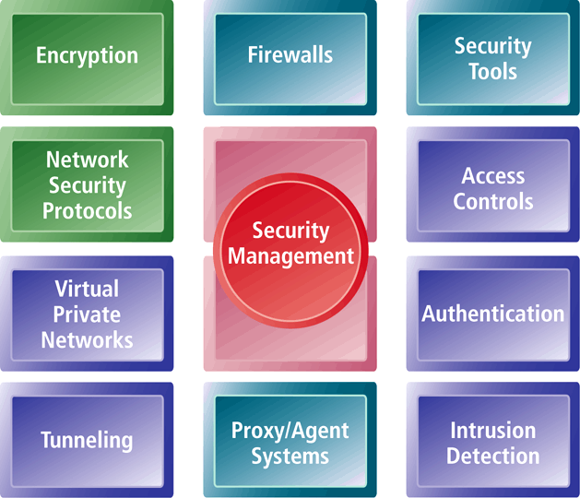
Tools Available to Achieve Site Security

Slide 19
Protecting Internet Communications: Encryption
Encryption: The process of transforming plain text or data into cipher text that cannot be read by anyone other than the sender and receiver
Purpose:
  Secure stored information
  Secure information transmission
Provides:
  Message integrity
  Nonrepudiation
  Authentication
  Confidentiality

Slide 20
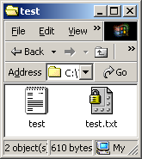
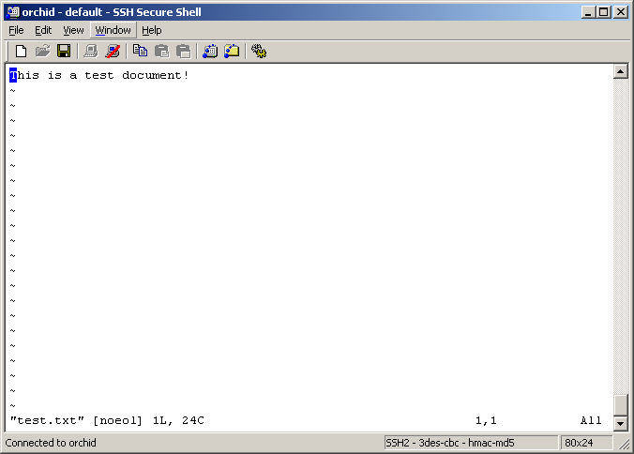
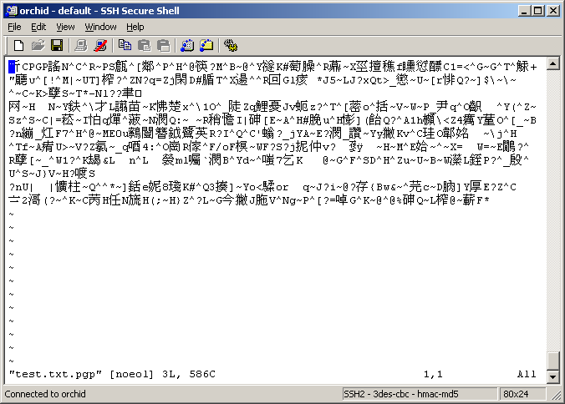
Message Encryption
Original Message
Encrypted Message

Slide 21
Transfer Encrypted Data
User A
User B
Encrypted
Text
Encrypted
Text
Insecure Channel

Slide 22
Symmetric Key Encryption
Also known as secret key encryption
Both the sender and receiver use the same digital key to encrypt and decrypt message
Requires a different set of keys for each transaction
Data Encryption Standard (DES): Most widely used symmetric key encryption today; uses 56-bit encryption key; other types use 128-bit keys up through 2048 bits

Slide 23
Symmetric Key Encryption:Transfer Encrypted Data
User A
User B
Encrypted
Text
Encrypted
Text
Insecure Channel

Slide 24
Public Key Encryption
Public key cryptography solves symmetric key encryption problem of having to exchange secret key
Uses two mathematically related digital keys – public key (widely disseminated) and private key (kept secret by owner)
Both keys are used to encrypt and decrypt message
Once key is used to encrypt message, same key cannot be used to decrypt message
For example, sender uses recipient’s public key to encrypt message; recipient uses his/her private key to decrypt it

Slide 25
Public Key Encryption: Decryption with your Private key
Encrypted
Text
Private key stored in
your personal computer
User B
Decryption
User B’s
Private key
Original Text

Slide 26
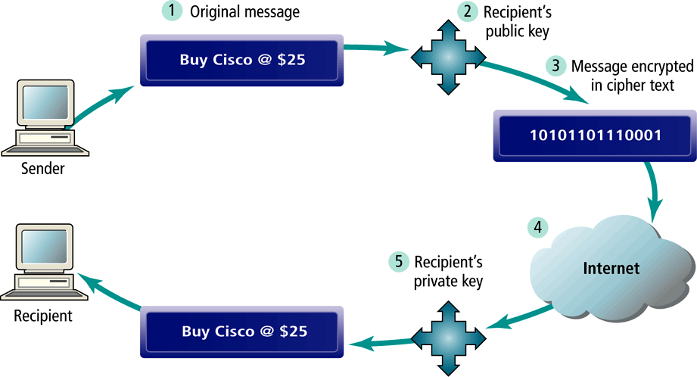
Public Key Cryptography – A Simple Case

Slide 27
Public Key Encryption using Digital Signatures and Hash Digests
Application of hash function (mathematical algorithm) by sender prior to encryption produces hash digest that recipient can use to verify integrity of data
Double encryption with sender’s private key (digital signature) helps ensure authenticity and no repudiation

Slide 28
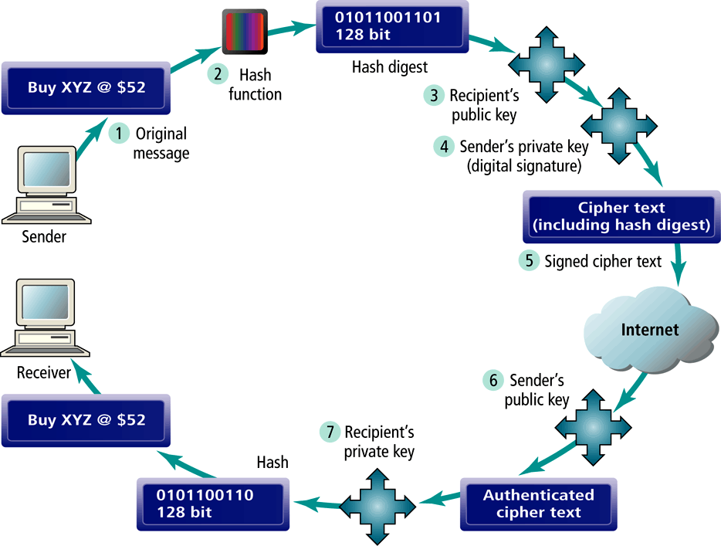
Public Key Cryptography with Digital Signatures

Slide 29
Digital Envelopes
Addresses weaknesses of public key encryption (computationally slow, decreases transmission speed, increases processing time) and symmetric key encryption (faster, but more secure)
Uses symmetric key encryption to encrypt document but public key encryption to encrypt and send symmetric key

Slide 30
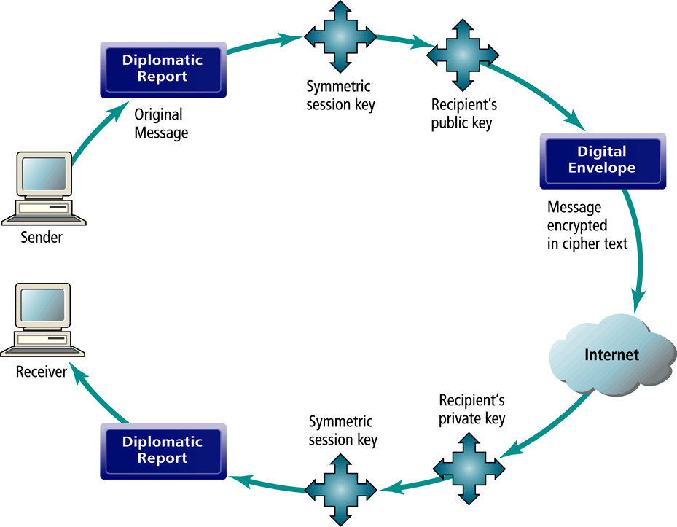
Public Key Cryptography: Creating a Digital Envelope

Slide 31
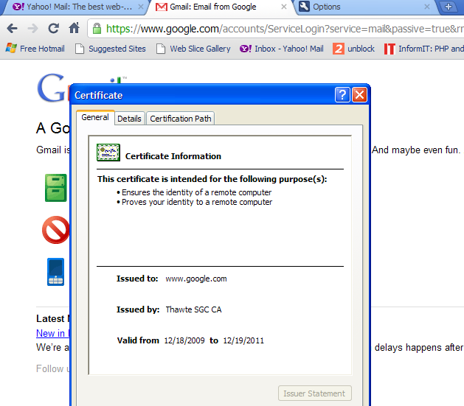
Digital Certificates and Public Key Infrastructure (PKI)

Slide 32
Digital Certificates and Public Key Infrastructure (PKI)
Digital certificate: Digital document that includes:
  Name of subject or company
  Subject’s public key
  Digital certificate serial number
  Expiration date
  Issuance date
  Digital signature of certification authority (trusted third party (institution) that issues certificate
  Other identifying information
Public Key Infrastructure (PKI): refers to the CAs and digital certificate procedures that are accepted by all parties

Slide 33
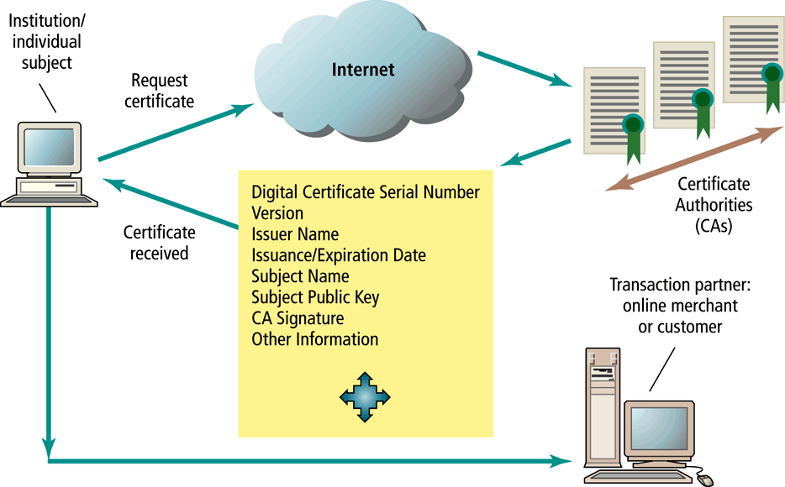
Digital Certificates and Certification Authorities

Slide 34
Limits to Encryption Solutions
PKI applies mainly to protecting messages in transit
PKI is not effective against insiders
Protection of private keys by individuals may be haphazard
No guarantee that verifying computer of merchant is secure
CAs are unregulated, self-selecting organizations

Slide 35
Securing Channels of Communication
Secure Sockets Layer (SSL): Most common form of securing channels of communication; used to establish a secure negotiated session (client-server session in which URL of requested document, along with contents, is encrypted)
S-HTTP: Alternative method; provides a secure message-oriented communications protocol designed for use in conjunction with HTTP
Virtual Private Networks (VPNs): Allow remote users to securely access internal networks via the Internet, using Point-to-Point Tunneling Protocol (PPTP)

Slide 36
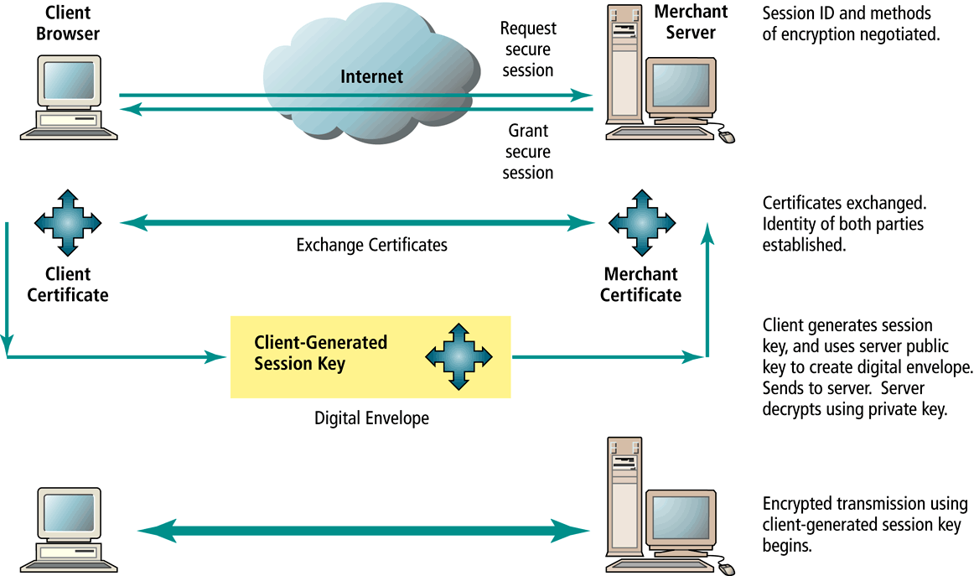
Secure Negotiated Sessions Using SSL

Slide 37
Protecting Networks: Firewalls and Proxy Servers
Firewall: Software application that acts as a filter between a company’s private network and the Internet
Firewall methods include:
  Packet filters
  Application gateways
Proxy servers: Software servers that handle all communications originating from for being sent to the Internet (act as “spokesperson” or “bodyguard” for the organization)

Slide 38
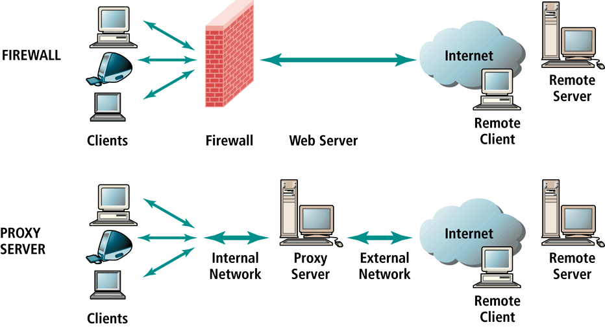
Firewalls and Proxy Servers

Slide 39
Protecting Servers and Clients
Operating system controls: Authentication and access control mechanisms
Anti-virus software: Easiest and least expensive way to prevent threats to system integrity

Slide 40
A Security Plan: Management Policies
Steps in developing a security plan:
  Perform risk assessment – assessment of risks and points of vulnerability
  Develop security policy – set of statements prioritizing information risks, identifying acceptable risk targets and identifying mechanisms for achieving targets
  Develop implementation plan – action steps needed to achieve security plan goals
  Create security organization – in charge of security; educates and trains users, keeps management aware of security issues; administers access controls, authentication procedures and authorization policies
  Perform security audit – review of security practices and procedures

Slide 41
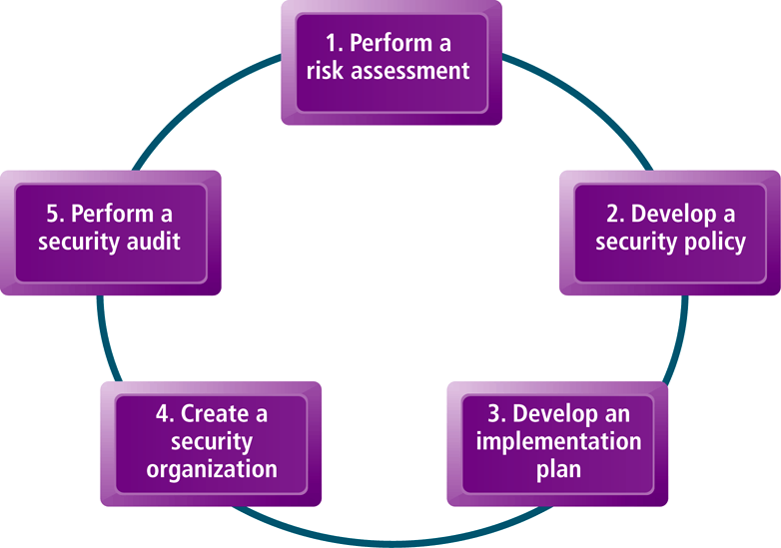
Developing an E-commerce Security Plan

