Slide 1
E-commerce
E-commerce Payment Systems
Aemro B.

Slide 2
Learning Objectives
Describe the features of traditional payment systems
Discuss the current limitations of online credit card payment systems
Understand the features and functionality of digital wallets
Describe the features and functionality of the major types of digital payment systems in the B2C arena
Describe the features and functionality of the major types of digital payment systems in the B2B arena
Describe the features and functionality of electronic billing presentment and payment systems

Slide 3
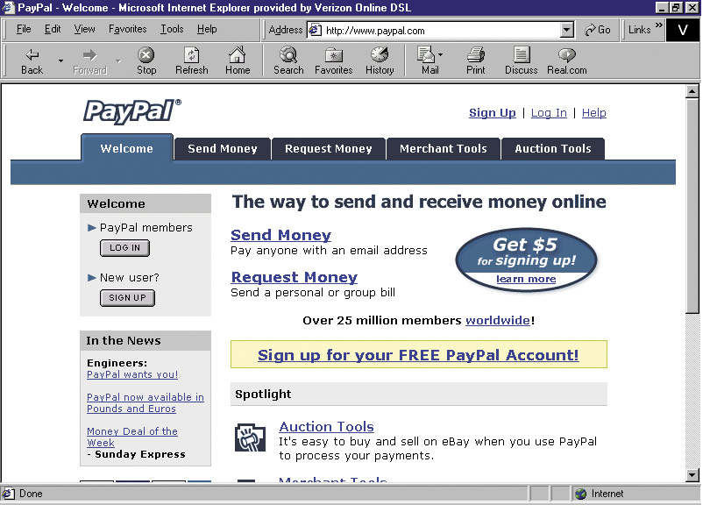
PayPal: The Money’s in the E-mail

Slide 4
PayPal: The Money’s in the E-mail
One of e-commerce’s major success stories:
Went public in 2002; acquired by eBay October 2002 for $1.5 billion
An example of a “peer-to-peer” payment system
Fills a niche that credit card companies avoided – individuals and small merchants
Weakness: suffers from relatively high levels of fraud
Competitors include Western Union (MoneyZap), AOL (AOLQuickcash) and Citibank (C2it)

Slide 5
Types of Payment Systems
Cash
Checking Transfer
Credit Card
Stored Value
Accumulating Balance

Slide 6
Cash
Legal tender defined by a national authority to represent value
Most common form of payment in terms of number of transactions
Instantly convertible into other forms of value without intermediation of any kind
Portable, requires no authentication, and provides instant purchasing power
“Free” (no transaction fee), anonymous, low cognitive demands
Limitations: easily stolen, limited to smaller transaction

Slide 7
Checking Transfer
Funds transferred directly via a signed draft or check from a consumer’s checking account to a merchant or other individual
Most common form of payment in terms of amount spend
Can be used for both small and large transactions
Not anonymous, require third-party intervention (banks)
Introduce security risks for merchants (forgeries, stopped payments), so authentication typically required

Slide 8
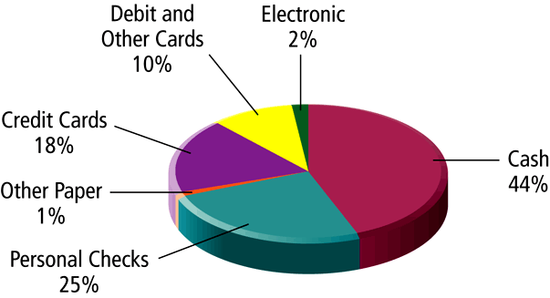
Most Common Payment Systems, Based on Number Of Transactions

Slide 9
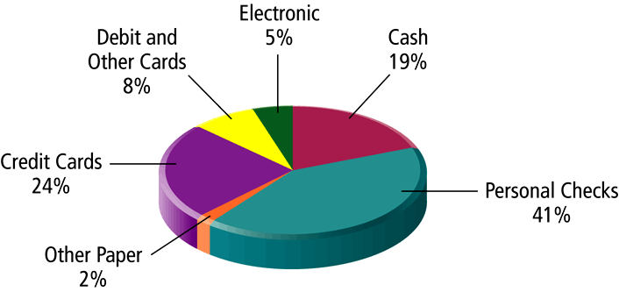
Most Common Payment Systems, Based on Dollar Amount

Slide 10
Credit Card
Represents an account that extends credit to consumers, permitting consumers to purchase items while deferring payment, and allows consumers to make payments to multiple vendors at one time
Credit card associations – Nonprofit associations (Visa, MasterCard) that set standards for issuing banks
Issuing banks – Issue cards and process transactions
Processing centers (clearinghouses) – Handle verification of accounts and balances

Slide 11
Stored Value
Accounts created by depositing funds into an account and from which funds are paid out or withdrawn as needed
Examples: Debit cards, gift certificates, prepaid cards, smart cards
Debit cards: Immediately debit a checking or other demand-deposit account
Peer-to-peer payment systems such as PayPal a variation

Slide 12
Accumulating Balance
Accounts that accumulate expenditures and to which consumers make period payments
Examples: utility, phone, American Express accounts

Slide 13
Current Online Payment Systems
Credit cards are dominant form of online payment, accounting for around 80% of online payments in 2002
New forms of electronic payment include:
Digital cash
Online stored value systems
Digital accumulating balance payment systems
Digital credit accounts
Digital checking

Slide 14
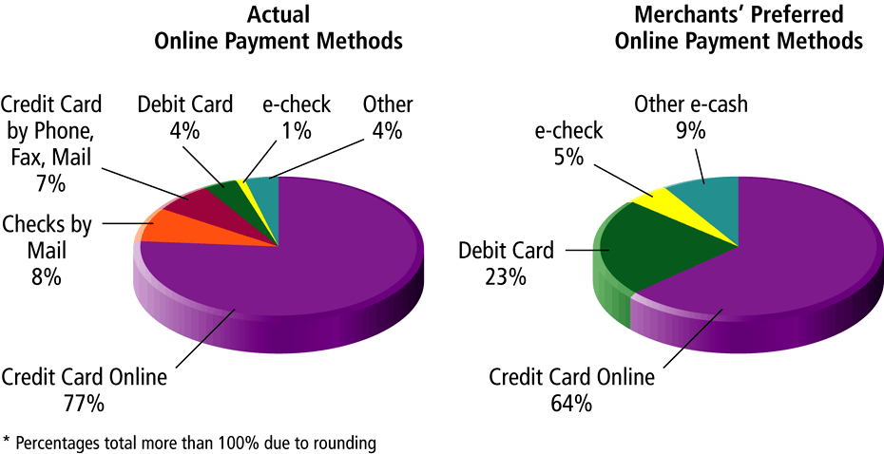
Online Merchants’ Actual and Preferred Online Payments

Slide 15
How an Online Credit Card Transaction Works
Processed in much the same way that in-store purchases are
Major difference is that online merchants do not see or take impression of card, and no signature is available (CNP transactions)
Participants include consumer, merchant, clearinghouse, merchant bank (acquiring bank) and consumer’s card issuing bank

Slide 16
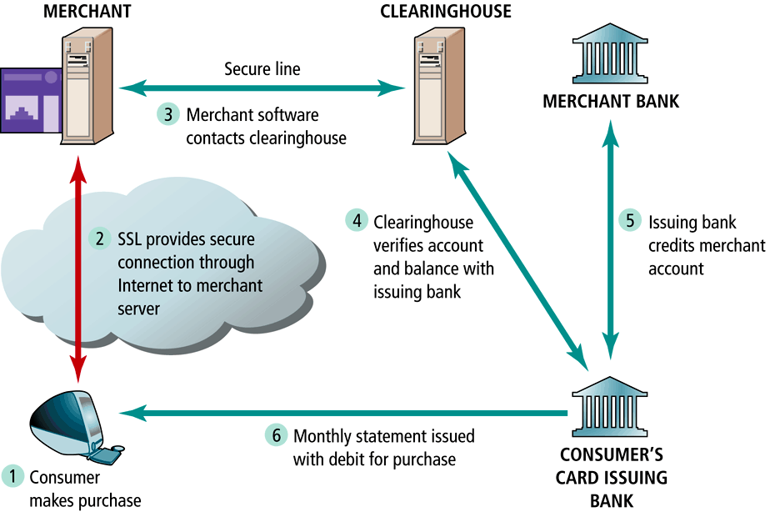
How an Online Credit Transaction Works

Slide 17
Limitations of Online Credit Card Payment Systems
Security – neither merchant nor consumer can be fully authenticated
Cost – for merchants, around 3.5% of purchase price plus transaction fee of 20-30 cents per transaction
Social equity – many people do not have access to credit cards (young adults, plus almost 100 million other adult Americans who cannot afford cards or are considered poor risk)

Slide 18
The SET (Secure Electronic Transaction) Protocol
Authenticates cardholder and merchant identity through use of digital certificates
An open standard developed by MasterCard and Visa
Transaction process similar to standard online credit card transaction, with more identity verification
Thus far, has not caught on much, due to costs involved in integrating SET into existing systems, and lack of interest among consumers

Slide 19
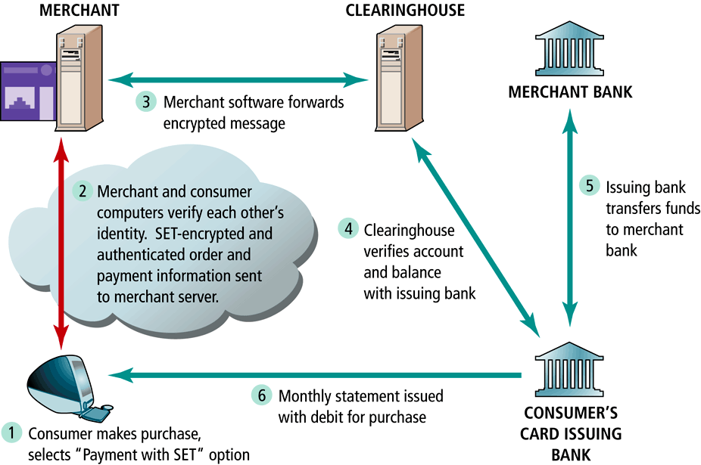
How SET Transactions Work

Slide 20
Digital Wallets
Concept of digital wallet relevant to many of the new digital payment systems
Seeks to emulate the functionality of traditional wallet
Most important functions:
Authenticate consumer through use of digital certificates or other encryption methods
Store and transfer value
Secure payment process from consumer to merchant
Two major categories:
Client-based digital wallets – Gator.com, MasterCard Wallet
Server-based digital wallets – MSN Wallet

Slide 21
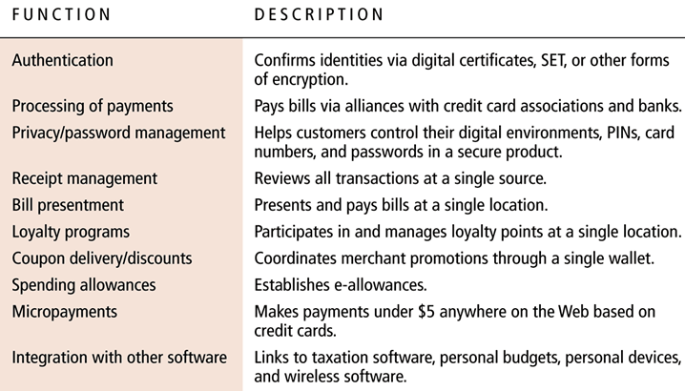
Promised Functionality of Digital Wallets

Slide 22
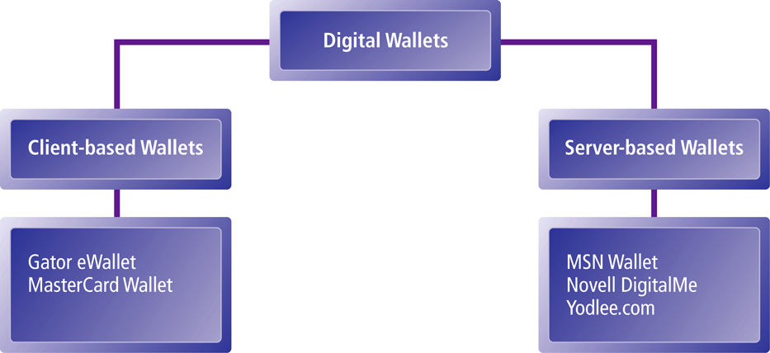
Types of Digital Wallets

Slide 23
Digital Cash
One of the first forms of alternative payment systems
Not really “cash” – rather, are forms of value storage and value exchange that have limited convertibility into other forms of value, and require intermediaries to convert
Many of early examples have disappear; concepts survive as part of P2P payment systems

Slide 24
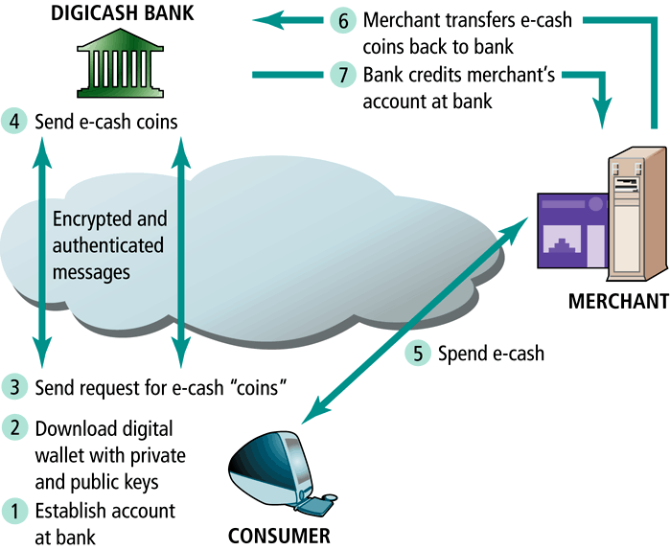
Digicash: How First Generation Digital Cash Worked

Slide 25
Online Stored Value Systems
Permit consumers to make instant, online payments to merchants and other individuals based on value stored in an online account
Rely on value stored in a consumer’s bank, checking or credit card account

Slide 26
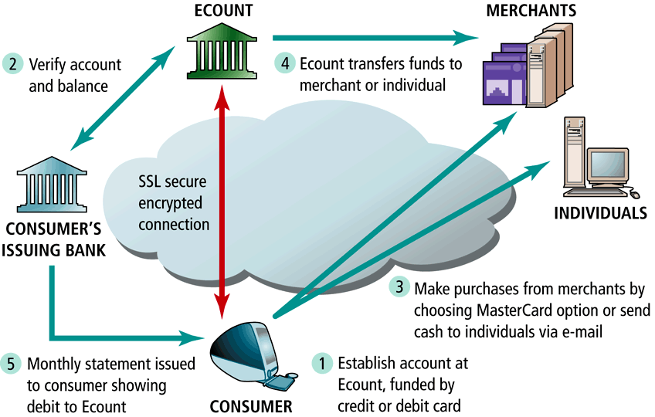
How Ecount.com Works: A Stored Value System

Slide 27
Smart Cards as Stored Value Systems
Another kind of stored value system based on credit-card sized plastic cards that have embedded chips that store personal information
Two types:
Contact
Contactless
Examples: Mondex, American Express Blue

Slide 28
Digital Accumulating Balance Payment Systems
Allows users to make micropayments and purchases on the Web, accumulating a debit balance for which they are billed at the end of the month
Examples: Qpass and iPin

Slide 29
Digital Credit Card Payment Systems
Extend the functionality of existing credit cards for use as online shopping payment tools
Focus specifically on making use of credit cards safer and more convenient for online merchants and consumers
Example: eCharge

Slide 30
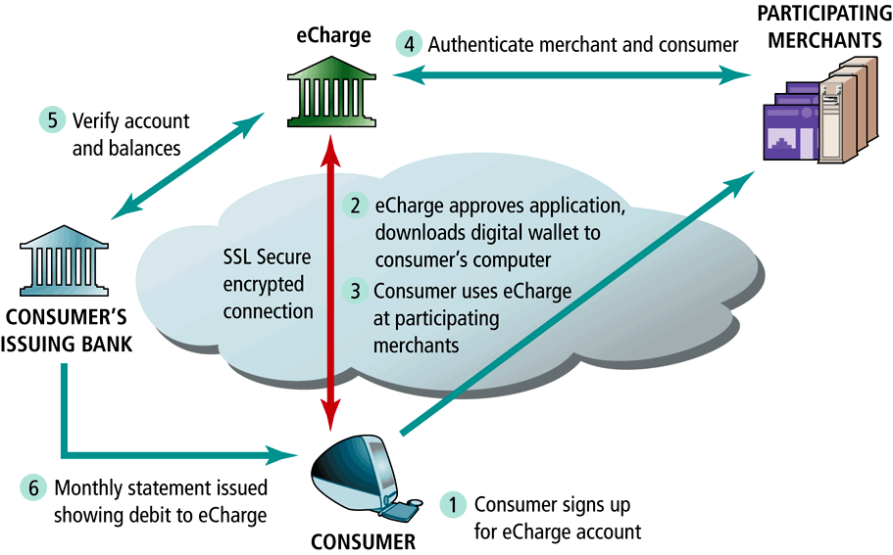
How a Digital Credit Card Payment Systems Works: eCharge

Slide 31
Digital Checking Payment Systems
Extend the functionality of existing checking accounts for use as online shopping payment tools
Examples: eCheck, Achex (MoneyZap)

Slide 32
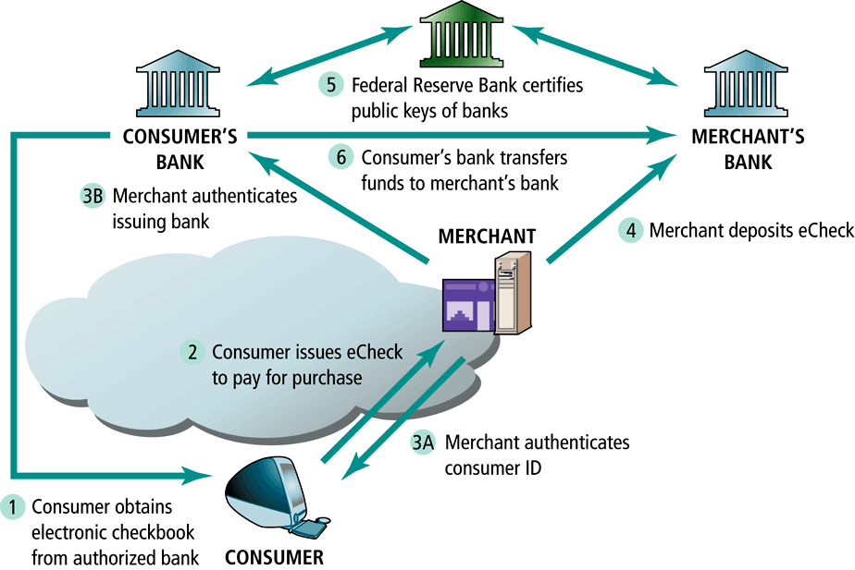
How Digital Checking Works: eCheck

Slide 33
Electronic Billing Presentment and Payment
Online payment systems for monthly bills
EBPP expected to grow rapidly, to nearly half all U.S. households by 2006
Different types of business models in EBPP market include:
Biller-direct
Consolidator
Portal

Slide 34
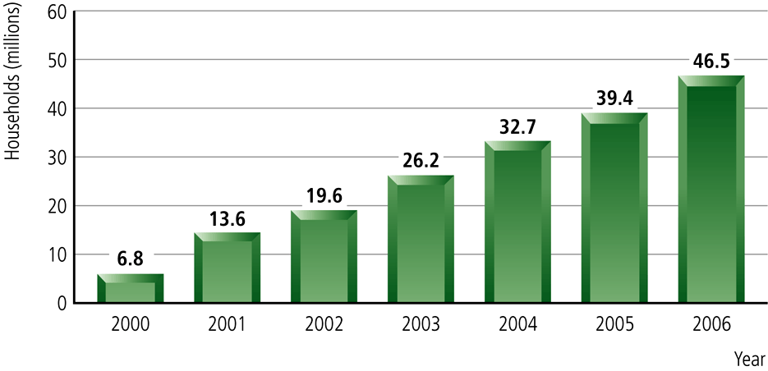
Growth of the EBPP Market

Slide 35
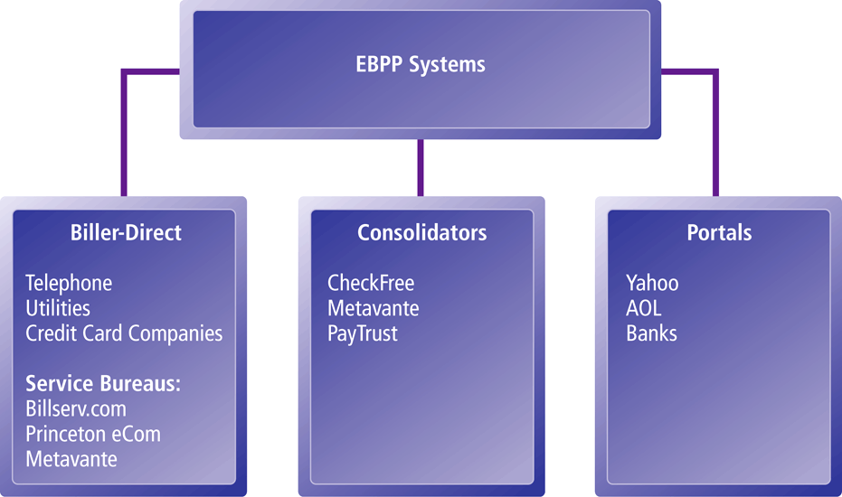
Types of EBPP Systems

