Slide 1
Chapter Two
Requirements Engineering Process
By Esubalew A.

Slide 2
  Contents
What is process?
Requirement Engineering process
RE process variability
Process Models
Actors in Requirements engineering process
Process support
Process Improvement
  Process Maturity
  A requirement engineering process maturity model
  Good practice for RE process improvement

Slide 3
What is process?
A process is an organized set of activities which transforms inputs to outputs
Process descriptions (should be as complete, consistent and clear) encapsulate knowledge and allow it to be reused
  Once someone has worked out how to solve a problem, they can document the way in which that solution was derived as a process.
Examples of process descriptions
  Instruction manual for a dishwasher
  Cookery book
  Procedures manual for a bank
  Quality manual for software development
Process may be defined in
  a very fine level of detail (steps followed exactly they appear)
  An abstract way (process user may enact the process)

Slide 4
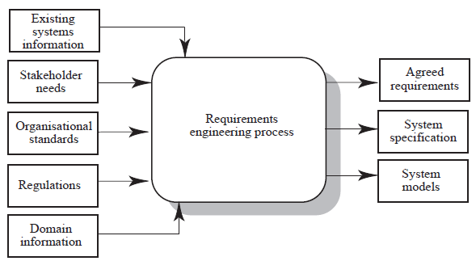
Requirement Engineering process
…

Slide 5
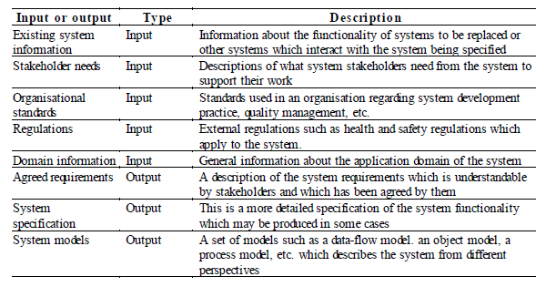
Requirement Engineering process...
…

Slide 6
Requirement Engineering process
For Library information System(LIS) the following are example requirements for inputs
  Existing System information
    The LIS shall poll the bar code reader system and process all of the transaction requests every two seconds
  Stakeholder needs
    The system should provide a help facility which will explain the facilities of the system to new user. This help facility should be accessible from all user interface screens
  Organizational standards
    The system shall run on a Sun server running the Solaris 2.0 operating system
  Regulations
    The system shall include a facility to a print all of the personel information which is maintained for a library user
  Domain information
    Books are uniquely identified by an international Standard Book Number which is a 10 digit identifier

Slide 7
RE process variability
RE processes vary radically from one organization to another
Factors contributing to this variability include
  Technical maturity – technologies and methods used vary
  Disciplinary involvement – engineering & managerial disciples involved vary
  Organizational culture (psychology, attitudes, experiences, beliefs and values ) – culture of an organization has effect on all business processes
  Application domain – different applications need different RE process
There is therefore no ‘ideal’ requirements engineering process
Rather organizations should start with generic RE process and instantiate this into more detailed process which is appropriate to their own needs

Slide 8
Process Models
A process model is a simplified description of a process presented from a particular perspective.
No single model gives you a complete understanding of the process
To describe a process in detail it is usual to produce several different types of model giving different process information
Types of process model include:
  Coarse-grain activity models
    shows the major activities involved in particular process and shows and their approximate sequencing
    Used as starting point for process description with separate sections covering each box in the model

Slide 9
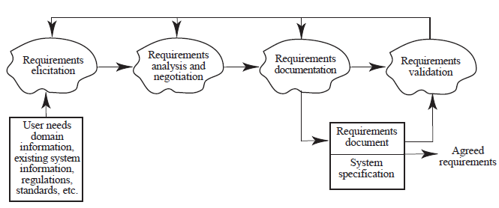
Process Models…
Coarse-grain activity model of RE

Slide 10
Process Models…
RE process activities
  Requirements elicitation
    Requirements discovered through consultation with stakeholders
  Requirements analysis and negotiation
    Requirements are analyzed and conflicts resolved through negotiation
  Requirements documentation
    A requirements document is produced
  Requirements validation
    The requirements document is checked for consistency and completeness

Slide 11
Process Models…
  Fine-grain activity models
    detailed model of a specific process.
    Used for understanding & for improving existing process
  Role-action models
    show the role of different people involved in the process & the actions which they take.
    Helpful for process understanding & automation
  Entity-relation models
    Show the process inputs, outputs & intermediate results & the relationships b/n them
    Used in a quality management system & supplement models of process activities

Slide 12
Actors in RE process
Actors in a process are the people involved in the execution of that process
Actors are normally identified by their roles e.g. project manager, purchasing director, system engineer rather than individually
Requirements engineering involves actors who are primarily interested in the problem to be solved (end-users, etc) as well actors interested in the solution (system designers, etc.)
Role-action diagrams are process models which show the actors associated with different process activities

Slide 13
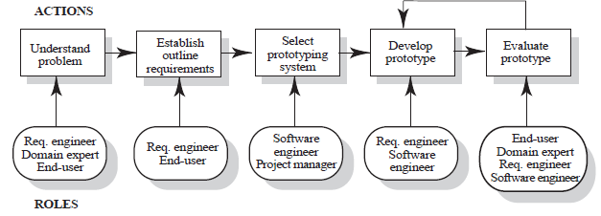
Actors in RE process...
Role Action Diagram (RAD) for software prototyping

Slide 14
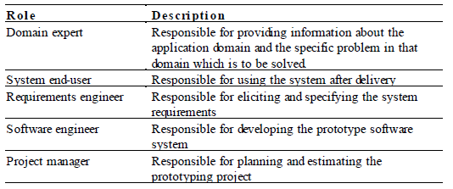
Actors in RE process...
Human and social factors
  Requirements engineering processes are dominated by human, social and organizational factors because they always involve a range of stakeholders from different backgrounds and with different individual and organizational goals.
  System stakeholders may come from a range of technical and non-technical background and from different disciplines

Slide 15
Process support
CASE tools provide automated support for software engineering processes
  CASE tools increase productivity (not though the scale predicted ) and product quality
The most mature CASE tools support well understood activities such as designing, programming and testing and the use of structured methods
Support for requirements engineering is still limited because of the informality and the variability of the process
  Some companies have developed their own tools which are directed towards their own RE process

Slide 16
Process support...
There are two types of tools which are available to support the requirement engineering process
  Modeling and validation tools
    support the development of system models which can be used to specify the system and the checking of these models for completeness and consistency.
    Modeling tools are developed based on structured methods SADT, or specialized requirement languages such as RSL.
    If a mathematical model of requirements are developed using (Z for example) then more extensive checkers may be used
    Examples: IBM’s Rational Rose, UML based various modeling tools, ..

Slide 17
Process support...
  Management tools
    Help to manage a database of requirements and support the management of changes to these requirements.
    These tools are developed to alleviate the problem of large amount of data collected in RE process & variability of requirements
    Examples: RequisitPro, DOORS
    Requirement Management tools provide a range of facilities to access the information about the requirements.
      Requirements browser
      Requirements query system
      Traceability support system
      Report generator
      Requirements converter and word processor linker
      Change control system

Slide 18
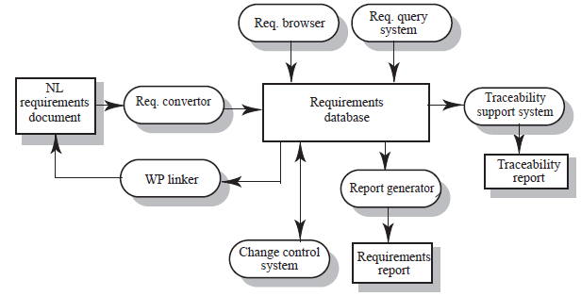
Process support...
A requirements management system

Slide 19
Process Improvement
Process improvement is concerned with modifying processes in order to meet some improvement objectives
Improvement objectives
  Quality improvement – fewer errors, more complete, better reflect real needs, etc
  Schedule reduction – output produced more quickly
  Resource reduction - fewer resources needed to enact the process
There are four questions which should be answered when planning process improvements
  What are the problems with current processes?
  What are the improvement goals?
  How can process improvement be introduced to achieve these goals?
  How should process improvements be controlled and managed?

Slide 20
Process Improvement...
RE process problems
  Lack of stakeholder involvement
  Business needs not considered
  Lack of requirements management
  Lack of defined responsibilities
  Stakeholder communication problems
  Over-long schedules and poor quality requirements documents
There is no standard set of process improvement which should be introduced nor is there a standard requirement engineering process which all organizations should be aiming to.
Rather, the appropriate improvement depend on the type of organization and the organizational culture

Slide 21
Process maturity
Process maturity can be thought of as the extent that an organization has defined its processes, actively controls these processes and provides systematic human and computer-based support for them.
  An organization which has defined a set of standards for processes and provide tool support for these standards is more mature than an organization with only informal process definition.
The SEI’s Capability Maturity Model (CMM) is a framework for assessing software process maturity in development organizations
The basic idea underlying the CMM approach is that organizations should asses their maturity then introduce process changes which will enable them to progress up the maturity ‘ladder’ in a five stage process.

Slide 22
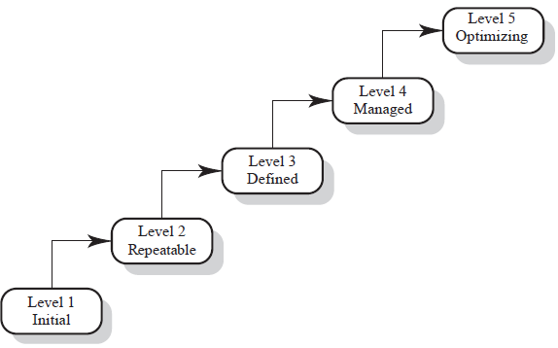
Process maturity…
….
Process Capability Maturity Model

Slide 23
Process maturity…
Level 1 - Initial (Chaotic)
  have undocumented and undisciplined process , the environment for the processes is chaotic or unstable
Level 2 – Repeatable
  Have basic cost and schedule management procedures in the and processes are repeatable, possibly with consistent results
Level 3 – Defined
  processes at this level are sets of defined and documented standard processes established and subject to some degree of improvement over time.
Level 4 – Managed
  Detailed measurements of both process and product quality are collected and used to control the process
Level 5 – Optimizing
  has a continuous process improvement strategy,

Slide 24
RE process Maturity Model
Requirement engineering process maturity is extent to which an organization has defined requirement engineering process based on good requirement engineering practice.
An organization with a mature RE process
  will have this process explicitly defined.
  Will use appropriate methods and techniques
  Will have defined standards for requirement documents, requirement descriptions, etc
  Will have used automated tools to support the process
  Will have management policies and procedures in place to ensure that the process is followed
  May use process measurements to collect information about the process to help assess the value of process changes.

Slide 25
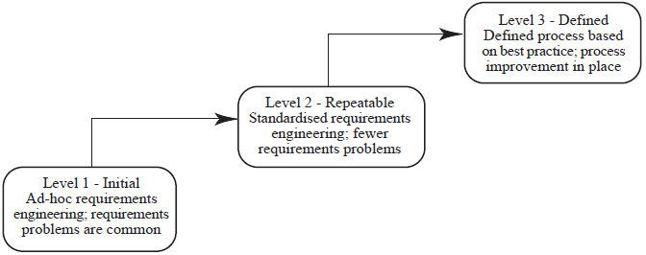
RE process Maturity Model…
The CMM is mostly concerned with the management of software development process and doesn’t cover RE process.
A comparable model of RE process maturity is discussed by Sommerville & Swayer, 1997.
The requirement process maturity model is three-level model

Slide 26
RE process Maturity Model…
Level 1: Initial Level
  Do not have a defined RE process & often suffer from requirements problems such as excessive requirements volatility, unsatisfied stakeholders & large rework costs when requirements change.
  They do not use advanced methods to support their requirements engineering process.
  They often fail to produce good quality requirement documents on time & within budget.
  The requirements are dependent on the skills and experience of individual engineers for requirements elicitation, analysis & validation.

Slide 27
RE process Maturity Model…
Level 2: Repeatable level
  Have defined standards for requirements documents and requirements descriptions and have introduced policies and procedures for requirements management.
  They may use some advanced tools and techniques in their RE process
  Their requirements documents are likely to be of a consistent high quality and to produced on schedule.
Levels: Defined level
  Have a defined requirements engineers process model based on good practice and techniques.
  They have an active process improvement programme in place and can make objective assessments of the value of new methods & techniques

Slide 28
Good practice for RE process improvement
RE processes can be improved by the systematic introduction of good requirements engineering practice
Each improvement cycle identifies good practice guidelines and works to introduce them in an organization
Examples of good practice guidelines
  Define a standard document structure
  Uniquely identify each requirement
  Define policies for requirements management
  Use checklists for requirements analysis
  Use scenarios to elicit requirements
  Specify requirements quantitatively
  Use prototyping to animate requirements
  Reuse requirements

Slide 29
Thank You!

