Slide 1
Requirement Elicitation and Analysis
Chapter 3
By Esubalew A.

Slide 2
  Contents
Requirements Elicitation
Difficulties of Requirements Elicitation
Components of Elicitation
Analysis & Negotiation
Elicitation , Analysis & Negotiation
The requirements elicitation process
The requirements Analysis & Negotiation Process
Elicitation Techniques
  Traditional techniques
  Collaborative techniques
  Cognitive techniques [Next class]
  Contextual approaches

Slide 3
  Requirements elicitation
Encompass all activities involved in discovering the requirements of a system
System developers and engineers work in close relationship with customer and end-users to
    Find out and understand the problems to be solved
    Find out and understand the functionalities of the system
    Find out the required “performance” of the solution
    Find out constraints, such as hardware and other, on the solution
It is not as simple as “let’s ask the users what they want.”
Why ? Because -------?

Slide 4
  Difficulties of Requirements Elicitation
User/Customer:
  Don’t always know all the requirements; may only know their own respective areas
    May not know the grand, organizational needs and objectives
    May not know the “politics” at play
  May give conflicting requirements
  May prioritize differently among themselves
  May intermix needs with wants
  May not have time or forget to give the complete picture etc.
Requirements Analyst:
  May not be a good listener
  May not understand the domain (the domain specific language) and misinterpret the user/customer meaning
  May not be trained, prepared or organized for elicitation
  May not have enough time etc.

Slide 5
  Difficulties of Requirements Elicitation…
Requirements elicitation is complicated by three endemic syndromes.
The "Yes, But" Syndrome
  For whatever reason, we always see two immediate, distinct, and separate reactions when the users see the system implementation for the first time.
    "Wow, this is so cool; we can really use this, what a neat job" and so on.
    "Yes, but, hmmmmm, now that I see it, what about this ... ? Wouldn't it be nice if . . . ? Whatever happened to . . . ?“

Slide 6
The "Yes, But" Syndrome
  The "Yes, But" syndrome is human nature and is an integral part of application development.
    We should plan for it.
  We can significantly reduce this syndrome by applying techniques that get the "Buts" out early.
  In so doing, we elicit the "Yes, But" response early, and we then can begin to invest the majority of our development efforts in software that has already passed the "Yes, But" test.

Slide 7
  Difficulties of Requirements Elicitation…
The "Undiscovered Ruins" Syndrome
  In many ways, the search for requirements is like a search for undiscovered ruins.
    The more you find, the more you know remain.
    You never really feel as though you have found them all, and perhaps you never will.
  Indeed, software development teams everywhere continually struggle to determine when they are done with requirements elicitation, that is, when have they found all the requirements that are material or when have they found at least enough?

Slide 8
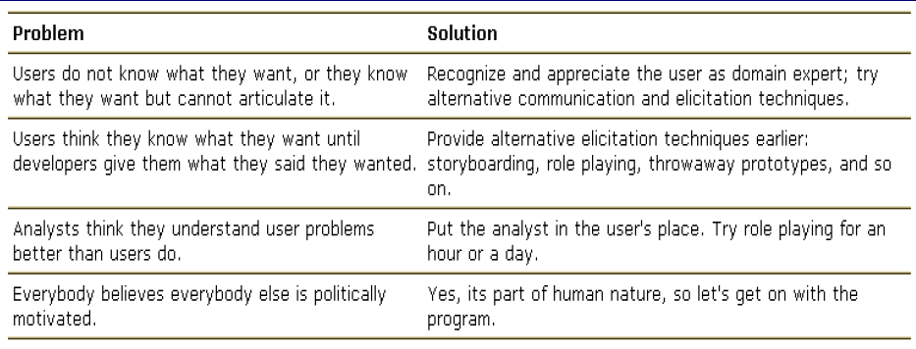
  Difficulties of Requirements Elicitation…
The "User and the Developer“ Syndrome
  Communication gap between the user and the developer.
    Users and developers are typically from different worlds, may even speak different languages, and have different backgrounds, motivations, and objectives.
  Reasons for this problem and some suggested solutions.

Slide 9
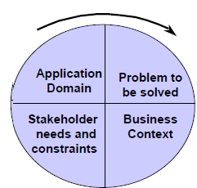
Components of Elicitation
Application domain understanding
  Application domain knowledge is knowledge of the general area where the system is applied.
Problem understanding
  details of the specific customer problem where the system will be applied must be understood.
Business understanding
  understand how systems interact and contribute to overall business goals.

Slide 10
Analysis & Negotiation
The objectives of requirement analysis & negotiation is to establish an agreed set of requirements which are complete and consistent.
During analysis process
  Missing requirements
  Requirements conflict
  Ambiguous requirements are discovered
  Overlapping requirements
  Unrealistic requirements
For conflicting & ambiguous requirements stakeholders should negotiate and agree on modifications and simplifications of the requirements

Slide 11
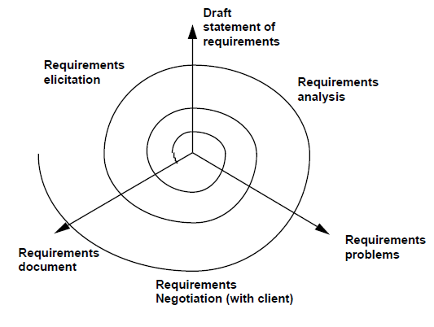
Elicitation, analysis and negotiation

Slide 12
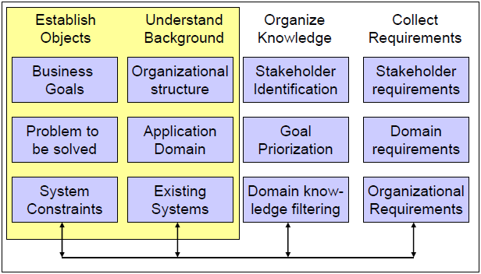
The requirements elicitation process
Objective setting: establish the overall organizational objectives: why is the system necessary?
Background of knowledge acquisition: gather and understand more background information about the system

Slide 13
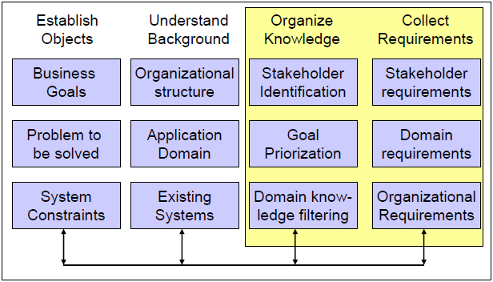
The requirements elicitation process…
Knowledge organization: organize, prioritize and collate/compare the large amount of data collected in the previous phases
Stakeholder requirements collection: involve system stakeholders to discover their requirements.

Slide 14
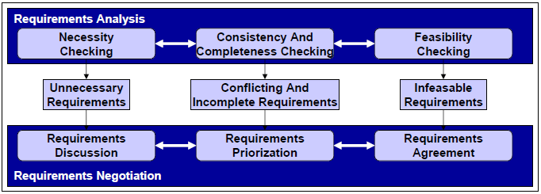
Requirements Analysis and Negotiation: Analysis
Necessity checking - Sometimes requirements don’t contribute to the business goals of the organization or to the specific problem to be addressed by the system
Consistency and completeness checking - Cross-checking for consistency and completeness (no contradictions, no services or constraints are missed out)
Feasibility checking - the context of the budget and schedule

Slide 15
Requirements Analysis and Negotiation: Negotiation
Requirements discussion - Requirements highlighted as problematical are discussed. The stakeholders involved present their views about the requirements
Requirements prioritization- Identification of critical requirements
Requirements agreement - A compromised set of requirements are agreed → changes to some of the requirements

Slide 16
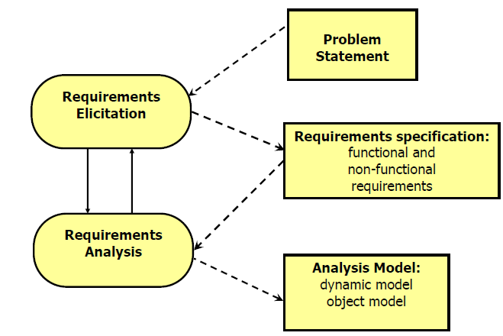
Process of Requirements Elicitation:
Products of Requirements Process
.
uses natural language
uses formal (Z, pi-calculus) or semi-formal notation (UML)

Slide 17
Problem Statement
The problem statement is developed by the client as a condensed description of the requirements that should be addressed by the system
  Describes the problem that should be solved
  It describes “what” is needed, not “how” it should be reached
The problem statement contains
  Current situation: The Problem to be solved (a few pages)
  Description of one or more scenarios
  Some initial requirements ( Functional and Non-functional requirements. No complete description)
  Project Schedule ( Major milestones that involve interaction with the client including deadline for delivery of the system)
  Target environment (The environment in which the delivered system has to perform a specified set of system tests
  Client Acceptance Criteria ( Criteria for the system tests)

Slide 18
Example: Library System
Idea: A Library Management System should be designed. Information on books, CDs, DVDs, Journals, etc. can be stored and retrieved. (problem statement)
Possible Requirements:
  Searching by Title, Author, and/or ISDN should be possible
  User Interface should be web-based (accessible via WWW Browser)
  At least 20 transactions per seconds should be possible
  All services should be available within 10 minutes
  Users have no access to personal data of other users

Slide 19
Elicitation techniques - Introduction
Specific techniques which may be used to collect knowledge about system requirements
This knowledge must be structured
  Partitioning - aggregating related knowledge
  Abstraction - recognizing generalities
  Projection – organizing knowledge from several perspectives
Requirements elicitation is cooperative process involving requirements engineers and system stakeholders.
  Problems:
    Not enough time for elicitation
    Inadequate preparation by engineers
    Stakeholders are unconvinced of the need for a new system

Slide 20
Elicitation techniques
Traditional techniques
  Introspection
  Reading existing documents
  Analyzing hard data
  Interviews
    Open-ended
    Structured
  Surveys / Questionnaires
  Meetings
Collaborative techniques
  Group techniques
  Focus Groups
  Brainstorming
  JAD/RAD workshops
  Prototyping
  Participatory Design
Cognitive techniques
  Task analysis
  Protocol analysis
  Knowledge Acquisition Techniques
    Card Sorting
    Laddering
    Repertory Grids
    Proximity Scaling Techniques
Contextual approaches
  Ethnographic techniques
    Participant Observation
    Enthnomethodology
  Discourse Analysis
    Conversation Analysis
    Speech Act Analysis
  Sociotechnical Methods
    Soft Systems Analysis

Slide 21
  Introspection
Is the mental thoughts of the requirements engineering about the wants and needs of the stakeholders about the systems.
  It amounts to imagining what kind of system I would want if I were doing this job, using this equipment, etc.
The introspection technique is the starting point for other requirement elicitation techniques.
Advantages
  It helps the other elicitation techniques. So it is a good starting activity for requirement elicitation.
  There are almost no costs of this technique.
Disadvantages
  In case of using the introspection the analyst should not only be familiar with the domain and goals of the system, but also should be expert in the business processes of the users.
  In other words this technique requires a huge experience of the requirement analyst.

Slide 22
Background Reading
Sources of information:
  Company reports, organization charts, policy manuals, job descriptions, reports, documentation of existing systems, etc.
Advantages:
  Helps the analyst to get an understanding of the organization before meeting the people who work there.
  Helps to prepare for other types of fact finding
    e.g. by being aware of the business objectives of the organization.
  May tell you the detailed requirements for the current system.
Disadvantages:
  Written documents often do not match up to reality.
  Can be long-winded with much irrelevant detail
Appropriate for - Whenever you are unfamiliar with the organization being investigated.

Slide 23
“Hard Data” Collection
Identify Collections of Hard Data
  Facts and figures, financial information,…
  Reports used for decision making,…
  Survey results, marketing data,…
Sampling
  Sampling used to select representative set from a population
    Purposive Sampling - choose the parts you think are relevant without worrying about statistical issues
    Simple Random Sampling - choose every kth element
    Stratified Random Sampling - identify strata/class and sample each
    Clustered Random Sampling - choose a representative subpopulation and sample it

Slide 24
“Hard Data” Collection…
  Sample Size is important
    balance between cost of data collection/analysis and required significance
  Process (How?):
    Decide what data should be collected - e.g. banking transactions
    Determine the population to be sampled - e.g. all transactions at 5 local branches over one week
    Choose type of sample - e.g. simple random sampling
    Choose sample size - e.g. every 10th transaction

Slide 25

Example of
hard data

Slide 26
Interview
Probably the most common technique of requirements elicitation.
Interviewers must be open-minded and should not approach the interview with pre-conceived notions about what is required
Stakeholders must be given a starting point for discussion (a question, a requirements proposal, an existing system)
Interviewers must be aware of organizational politics
  Some requirements may not be discussed because of their political implications
Interviews with different stakeholders →Different perspectives
Interviews no good way for understanding concepts of application domain

Slide 27
Interviews Different Techniques
Structured (closed) interviews
  Stakeholders answer a predefined set of questions
  Easy to analyze (+)
  Well-formed questions generate well-formed answers (you have to know your goals) (+)
  Knowledge about what and how to ask (-)
Non-structured (open) interviews
  No predefined agenda
  Generating new ideas (experimental, brain storming) (+)
  sometimes hard to handle (dynamics of discussion) (-)
In practice: mixed interview types are normal

Slide 28
Interviews: Written vs. oral interviews, group vs. single
Oral interviews:
  possibility to discussion (+)
  interviewer may influence interviewee (-)
Written interviews
  problems in understanding (-)
  already transcribed, thus easy to analyze (+)
Interviewing a single person:
  individual opinions (+)
Interviewing a group of people: -
  Involvement of many perspectives
  Developer need experience to moderate (-)
  Sometimes single or silent opinions are not noticed (-)
  Independent Moderator can mediate between group

Slide 29
Interviewing Tips
Prepare some initial questions → good entry point
Do not press the interviewee through the questionnaire
Restrict the time frame for the questionnaire (approx. 1 hour)
  Announce the estimated time for the interview
Short introduction for the purpose of the interview
Ensure anonymity (if necessary)
Make notes to the answers
  Explain the purpose of the records (reduces potential fear!)
Do not interrupt the interviewee’s flow of words
Allow people to refuse a question (don’t insist on answers!)
Announce feedback (evaluation) at the end

Slide 30
Interviewing …
Advantages
  Rich collection of information
  Good for uncovering opinions, feelings, goals, as well as hard facts
  Can probe in depth, & adapt follow up questions to what the person tells you
Disadvantages
  Large amount of qualitative data can be hard to analyze
  Hard to compare different respondents
  Interviewing is a difficult skill to master

Slide 31
Surveys and Questionnaires
Advantages
  Can quickly collect info from large numbers of people
  Can be administered remotely
  Can collect attitudes, beliefs, characteristics
Disadvantages
  Simplistic (presupposed) categories provide very little context
  No room for users to convey their real needs
Watch for:
  Bias in sample selection & in self-selecting respondents
  Small sample size (lack of statistical significance)
  Open ended questions (very hard to analyze!)
  Appropriation (“What is this a picture of?”)
  Ambiguous questions (I.e. not everyone is answering the same question)

Slide 32
Meetings
Used for summarization and feedback
  E.g. meet with stakeholders towards the end of each stage:
    to discuss the results of the information gathering stage
    to conclude on a set of requirements
    to agree on a design etc.
  Use the meeting to confirm what has been learned, talk about findings
Meetings are an important managerial tool
  Used to move a system development project forward.
  Need to determine objectives for the meeting:
    E.g. presentation, problem solving, conflict resolution, progress analysis, gathering and merging of facts, training, planning,...

Slide 33
Meetings…
  Plan the meeting carefully
    Schedule the meeting and arrange for facilities
    Prepare an agenda and distribute it well in advance
    Keep track of time and agenda during the meeting
    Follow up with a written summary to be distributed to meeting participants
    Special rules apply for formal presentations, walkthroughs, brainstorming, etc.

