Slide 1
Chapter 2: Design Patterns [Creational Patterns]
By Esubalew

Slide 2
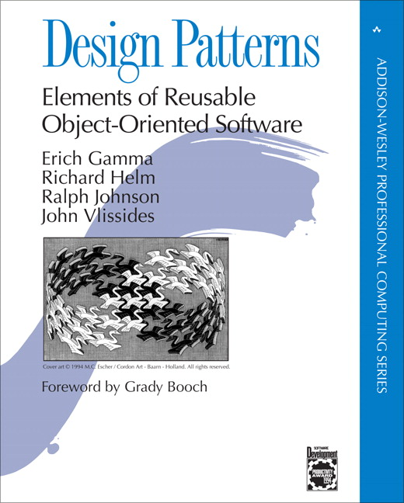
Contents
Origine of Design Patterns
What are patterns?
Examples of patterns
Benefits Patterns
Design Patterns Abuse
Types of design patterns
Design pattern Space
Creational Design Patterns
Abstract Factory pattern
Build Pattern
Factory Pattern
Prototype Pattern
Singliton Pattern

Slide 3
Origins of Design Patterns
“Each pattern describes a problem which occurs over and over again in our environment, and then describes the core of the solution to that problem, in such a way that you can use this solution a million times over, without ever doing it the same way twice“
Christopher Alexander, A Pattern Language, 1977
Context: City Planning and Building architectures

Slide 4
What are Design Patterns?
Design pattern is
a generalized reusable solution
to a commonly occurring problem in software design
in defined context ( the general situation in which pattern applies)
A design pattern is not a finished design that can be transformed directly into code. [Patterns are not panacea]
It is a description or template for how to solve a problem that can be used in many different situations
Many of them have been systematically documented for all software developers to use
A good pattern should be as general as possible contain a solution that has been proven to effectively solve the problem in the indicated context.

Slide 5
Elements of Design Patterns
Design patterns must be described in an easy-to-understand form so that people can determine when and how to use it.
Minimum parameters to describe patterns are
Name - Important because it becomes part of a design vocabulary
Problem - describes intent, context, and when the pattern is applicable
Solution - Design elements and their relationships.
Abstract: must be specialized
Consequences - Tradeoffs of applying the pattern
Each pattern has costs as well as benefits
Issues include flexibility, extensibility, etc.
Each pattern in GoF is documented with following specifications:
Intent, also known as, motivation, applicability, structure, participants, collaborations, consequences, implementation, sample code, known uses, related patterns

Slide 6
Elements of Design Patterns……
I have used the following parameters to describe each pattern
Intent - A short statement that answers the following questions: What does the design pattern do? What is its rationale and intent? What particular design issue or problem does it address?
Motivation or Example- A scenario that illustrates a design problem and how the class and object structures in the pattern solve the problem. The scenario will help you understand the more abstract description of the pattern.
Applicability- What are the situations in which the design pattern can be applied? What are examples of poor designs that the pattern can address? How can you recognize these situations?
Consequences- How does the pattern support its objectives? What are the trade-offs and results of using the pattern? What aspect of system structure does it let you vary independently?
Known Uses
Related Patterns - What design patterns are closely related to this one? What are the important differences? With which other patterns should this one be used?

Slide 7
Examples of patterns
Design patterns you have already seen
Encapsulation (Data Hiding)
Sub-classing (Inheritance)
Iteration
Exceptions
Encapsulation Pattern
Problem: Exposed fields are directly manipulated from outside, leading to undesirable dependences that prevent changing the implementation.
Solution: Hide some components, permitting only stylized access to the object.

Slide 8
Examples of patterns…
Sub-classing pattern
Problem: Similar abstractions have similar members (fields and methods). Repeating these is tedious, error-prone, and a maintenance headache.
Solution: Inherit default members from a super-class; select the correct implementation via run-time dispatching.
Iteration pattern
Problem: Clients that wish to access all members of a collection must perform a specialized traversal for each data structure.
Solution: Implementations perform traversals. The results are communicated to clients via a standard interface.
Exceptions Pattern
Problem: Code is cluttered with error-handling code.
Solution: Errors occurring in one part of the code should often be handled elsewhere. Use language structures for throwing and catching exceptions.

Slide 9
Why Patterns?
Speed up the development process by providing tested, proven development paradigms.
Shared language of design
Increases communication bandwidth because it has consistent documentation
Decreases misunderstandings
Learn from experience
Becoming a good designer is hard
Understanding good designs is a first step
Tested solutions to common problems
Used to achieve the following quality attributes;
Modifiability, Exchangeability, Reusability, Extensibility, Maintainability, Reliability, Testability
Patterns help you to manage software complexity.

Slide 10
Design Patterns Abuse
Don’t try to use design patterns for the sake of using patterns
Over-engineering is the process of over complicating something.
In the case of programming, making your code more complex and possibly more flexible than it needs to be.
More specifically, implementing complex software design patterns on simple problems.
How to avoid over-engineering
Start simple not complex
Consider refactoring to a design pattern rather than starting from one
Don’t force yourself to get it right the first time

Slide 11
Types of Design Patterns
Design pattern are granular and applied at different levels such as frameworks, and subsystems
GRASP Patterns
General Responsibility Assignment Software Pattern
E.g. Information Expert, Creator, Low Coupling, High Cohesion
Architectural patterns
An architectural pattern express a fondamental structural organisation schema for software Systems
Design patterns
Creational Patterns- initializing and configuring classes and objects
Structural Patterns - integration and composition of classes and objects
Behavioral Patterns -dynamic interactions among societies of classes and objects
Idioms
An Idiom is a low-level patterns specific to a programming language.

Slide 12
Design Patterns space
 |  | Purpose
 |  | Creational | Structural | Behavioral
Scope | Class | Factory Method | Adapter (class) | Interpreter Template Method
 | Object | Abstract Factory Builder Prototype Singleton | Adapter (object) Bridge Composite Decorator Facade Flyweight Proxy | Chain of Responsibility Command Iterator Mediator Memento Observer State Strategy Visitor
Defer object creation to another class
Defer object creation to another object
Describe ways to assemble objects
Describe algorithms and flow control

Slide 13
Creational Patterns
Abstract the instantiation process - Make a system independent of how its objects are created, composed, and represented
Creational pattern support the creation process by helping to provide the following capabilities
Generic instantiation – allows objects to be created in a system without having to identify a specific class type in code.
Simplicity – some patterns make object creation easier so callers will not have to write large, complex code to instantiate an object.
Creation constraint – some patterns create constraints on the type or number of objects that can be created within a system.
Five creational patterns have been documented by GoF
Abstract Factory - Factory Method - Singleton
Builder - Prototype

Slide 14
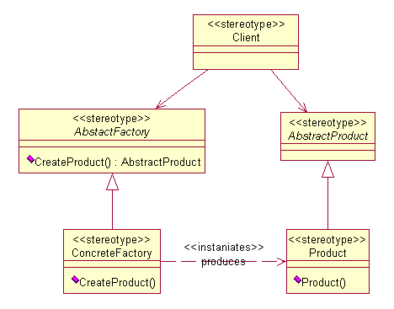
Abstract Factory
Intent - Provide an interface for creating families of related or dependent objects, without specifying their concrete classes
AbstractFactory - Declares an interface for operations that create abstract products
ConcreteFactory- Implements the operations to create concrete product objects: usually instantiated as a Singleton
AbstractProduct - Declares an interface for a type of product object; Concrete Factories produce the concrete products
ConcreteProduct - Defines a product object to be created by the corresponding concrete factory

Slide 15
Example : personal information manager (PIM) application
The PIM is combination address book, personal planner, and appointment and contact manager, and will use the Address and phoneNumber data extensively.
initially produce classes to represent your address and telephone number data. Code these classes so that they store the relevant information and enforce business rules about their format.
Shortly after coding your classes, you realize that you have to manage address and phone information for another country – which has different rules governing what constitutes a valid phone number and address
so you modify your logic in the Address and PhoneNumber classes to take the new country into account.
As more and more countries are added your classes became bloated leading to difficulty in managing and the code will be brittle
The Abstract Factory solves this problem- define an AddressFactory —a generic framework for producing objects that follow the general pattern for an Address and PhoneNumber

Slide 16
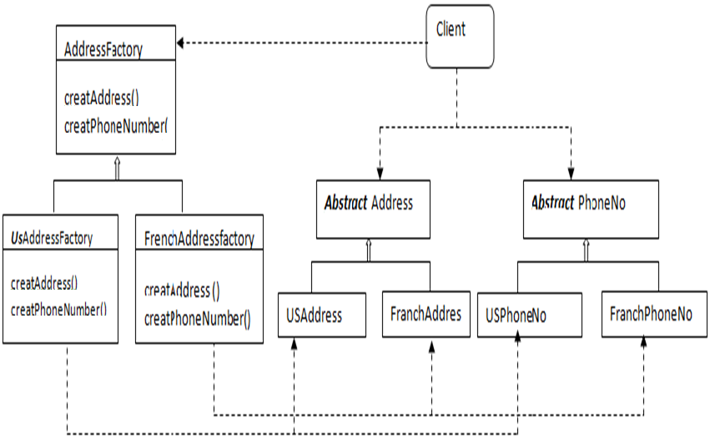
Abstract Factory…
Source Code

Slide 17
Abstract Factory…
Use Abstract Factory when
A client should be independent of how its products are created
The application should be configured with one of multiple families of products
You want to provide a class library of products, and you want to reveal just their interfaces, not their implementations
Only class interfaces, not implementations, are required.
Consequences
Isolates concrete classes
Makes exchanging product families easy - Just change the ConcreteFactory
Enforces consistency among products
Supporting new kinds of products is difficult - Have to reprogram AbstractFactory and all subclasses.

Slide 18
Abstract Factory…
Known Uses:
Look and Feel in Swing API
Connection in JDBC API
Related patterns:
Factory method - which is often implemented with an abstract factory.
Singleton - often implemented with an abstract factory.
Prototype - often implemented with an abstract factory.
Facade - often used with an abstract factory by providing an interface for creating implementing class.

Slide 19
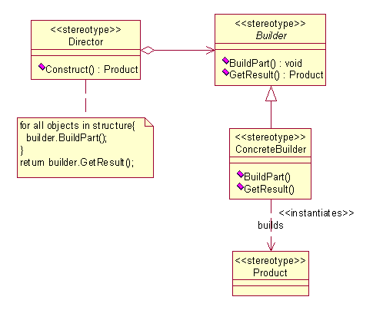
Builder pattern
Intent - Separate the construction of a complex object from its representation so that the same construction process can create different representations
Builder-Specifies an abstract interface for creating parts of a Product object
ConcreteBuilder -Constructs and assembles parts of the product by implementing the Builder interface
Director - Constructs an object using the Builder interface
Product - represents the complex object under construction. Includes classes that define the constituent parts

Slide 20
Example 1: PIM
In PIM, users might want to manage a social calendar. To do this, you might define a class called Appointment to the information for a single event, and track information like the following: Starting and ending dates, A description of the appointment, A location for the appointment, Attendees for the appointment.
Naturally, this information is passed in by a user through a constructor.
However different kinds of information are required depending on the specific type of the appointment: start & end date, attendee, single date may be required based on the appointment
Two possibilities way to mange this: create constructors for every type of appointment, or write an enormous constructor with a lot of functional logic.
Drawbacks
with multiple constructors, calling logic becomes more complex;
with more functional logic built into the constructor, the code becomes more complex and harder to debug.

Slide 21
Example 1: PIM…
Worse still, both approaches have the potential to cause problems if you later need to subclass Appointment.
Solution
delegate the responsibility of Appointment creation to a special AppointmentBuilder class, greatly simplifying the code for the Appointment itself.
The AppointmentBuilder contains methods to create the parts of the Appointment, and you call the AppointmentBuilder methods that are relevant for the appointment type.
the AppointmentBuilder can ensure that the information passed in when creating the Appointment is valid, helping to enforce business rules.
If you need to subclass Appointment, you either create a new builder or subclass the existing one.

Slide 22
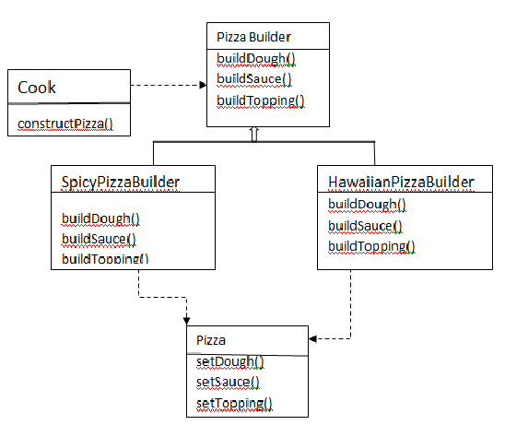
Builder patterns Example2
Source Code

Slide 23
Builder patterns…
Use Builder when
The algorithm for creating a complex object should be independent of the parts that make up the object and how they’re assembled
The construction process must allow different representations for the object being constructed
The building process can be broken down into discrete steps (difference between Builder and Abstract Factory)
Consequences:
It lets you vary a product's internal representation.
It isolates code for construction and representation.
Gives you the possibility to reuse and/or change the process and/or product independently.
It gives you finer control over the construction process

Slide 24
Builder patterns…
Known uses:
Configuration in Hibernate API,
StringBuilder in Lang API
Related patterns:
Abstract Factory - focuses on the layer over the factory pattern (may be simple or complex), whereas a builder pattern focuses on building a complex object from other simple objects.
Composite - often used to build a complex object.

Slide 25
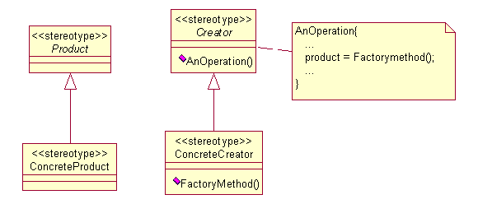
Factory Method pattern
Intent: Define an interface for creating an object, but let subclasses decide which class to instantiate. Factory Method lets a class defer instantiation to subclasses.
Creator - declares the factory method which returns object of type product
ConcreteCreator - Overrides factory method to return instance of ConcreteProduct
Product - defines the interface of objects the factory method creates
ConcreteProduct - Implements the product interface

Slide 26
Factory Method pattern...
Example - If we have a super class and n sub-classes, and based on data provided, we have to return the object of one of the sub-classes, we use a factory pattern.
Use the Factory Method pattern when
a class can´t anticipate the class of objects it must create.
a class wants its subclasses to specify the objects it creates.
classes delegate responsibility to one of several helper subclasses, and you want to localize the knowledge of which helper subclass is the delegate.
Consequences:
Provides hooks for subclasses
Connects parallel class hierarchies

Slide 27
Factory Method pattern...
Known Uses - DriverManager in JDBC API, DocumentBuilderFactory in XML API
Related Patterns:
Abstract Factory - a layer higher than a factory method.
Template method - defines a skeleton of an algorithm to defer some steps to subclasses or avoid subclasses
Prototype - creates a new object by copying an instance, so it reduces subclasses.
Singleton - makes a returned factory method unique.
Abstract Factory vs Factory method
With the Abstract Factory pattern, a class delegates the responsibility of object instantiation to another object via composition whereas the Factory Method pattern uses inheritance and relies on a subclass to handle the desired object instantiation.

Slide 28
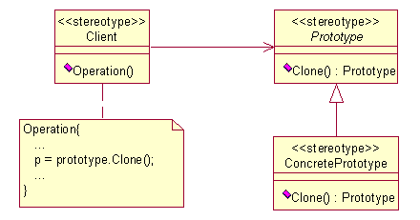
Prototype pattern
Intent - Specify the kinds of objects to create using a prototypical instance, and create new objects by copying this prototype.
If the cost of creating a new object is large and creation is resource intensive, we clone the object.

Slide 29
Prototype pattern : PIM Example
you want to be able to copy an address entry so that the user doesn’t have to manually enter all the information when creating a new contact. One way to solve this is to perform the following steps:
Create a new Address object & copy the appropriate values from the existing Address.
The above step works but it violets encapsulation
Solution - put method calls to copy the Address information, outside of the Address class.
However, this means that it becomes harder and harder to maintain the Address code, since it exists throughout the code for the project. It is also difficult to reuse the Address class in some new project in the future.
Best Solution
The copy code really belongs in the Address class itself, so why not instead define a “copy” method in the class?
This method produces a duplicate of the Address object with the same data as the original object—the prototype.
Source Code

Slide 30
Prototype pattern...
Use the Prototype pattern when
Classes to be instantiated are specified at run-time
It is more convenient to copy an existing instance than to create a new one
Avoiding the creation of a factory hierarchy is needed
Consequences
Adding and removing products at run-time.
Specifying new objects by varying values.
Specifying new objects by varying structure.
Reduced sub-classing.
Known uses - XML API Implementation, SimpleDateFormat in Util API
Related Patterns
Abstract Factory - often used together with prototype.
Composite - often used with prototypes to make a part-whole r/n s/p
Decorator- used to add additional functionality to the prototype.

Slide 31
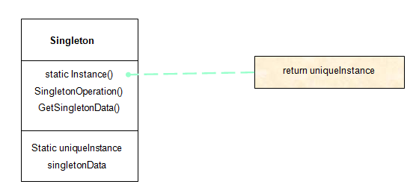
Singleton pattern...
Intent: Ensure a class only has one instance, and provide a global point of access to it.
Use the Singleton pattern when
there must be exactly one instance of a class, and it must be accessible to clients from a well-known access point.
when the sole instance should be extensible by subclassing, and clients should be able to use an extended instance without modifying their code.
class Singliton { private static Singliton instance = new Singliton(); // don’t let Java give you a default public constructor private Singliton() { } Singleton getInstance() { return instance; } ... }

Slide 32
Singleton pattern ...
Consequences
Controlled access to sole instance
Reduced name space
Permits refinement of operations and representations
Permits a variable number of instances
More flexible than class operations
Known uses – LogFactory in Apache Log4j , SecretKeyFactory in crypto API
Related patterns
Abstract factory - often used to return unique objects.
Builder - used to construct a complex object, whereas a singleton is used to create a globally accessible object.
Prototype - used to copy an object, or create an object from its prototype, whereas a singleton is used to ensure that only one prototype is guaranteed.

