Slide 1
Chapter 4: Achieving Qualities
By Esubalew

Slide 2
Contents
Introduction
Architectural Tactics
Availability Tactics (fault detection, fault recovery, fault prevention)
Modifiability Tactics(Localize modifications, Prevent ripple effects, Defer binding time)
Performance Tactics (Resource Demand, Resource Management, Resource Arbitration)
Security Tactics (Resisting attacks, Detecting attacks, Recovering from attacks)
Testability Tactics (Providing input and capturing output, Internal monitoring)
Usability Tactics (Runtime tactics, Design time tactics)
Relationship of Tactics to Architectural Patterns

Slide 3
Introduction
In lecture #6 we have seen how to characterize a number of system quality attributes in terms of a collection of scenarios in order to understand them.
Understanding what is meant by a quality attribute enables you to elicit the quality requirements but provides no help in understanding how to achieve them.
In this lecture we provide architectural guidance for the achievement of each of the six system quality attributes that we have elaborated.
A system design is a collection of design decisions
Some ensure achievement of the system functionality
Others help control the quality attribute responses (which we call the tactics)

Slide 4
Introduction…
A tactic is a design decision that influences the control of a quality attribute response.
A collection of tactics is called an architectural strategy.
Prior to deciding on a set of patterns to achieve the desired quality, the architect should consider what combination of tactics should be applied to achieve the specific quality
Patterns package tactics –e.g., a pattern that supports availability will likely package both redundancy and synchronization tactics.
Tactics can refine other tactics – e.g., redundancy is a tactic in achieving availability and it can be refined into redundancy of data or redundancy of computation.
Tactics
to Control
Response
Stimulus
Response

Slide 5
Availability Tactics
A fault (or combination of faults) has the potential to cause a failure.
Recovery or repair is an important aspect of availability.
The tactics we discuss in this section will keep faults from becoming failures or at least bound the effects of the fault and make repair possible.
All approaches to maintaining availability involve some type of redundancy, some type of health monitoring to detect a failure, and some type of recovery when a failure is detected.
Three categories of availability are
Fault Detection
Fault Recovery
Fault Prevention.
Tactics
to Control
Availability
Fault
Fault Masked or Repair Made

Slide 6
Availability Tactics: Fault Detection Tactics
Three widely used tactics for recognizing faults are ping/echo, heartbeat, and exceptions.
Ping/echo
One component issues a ping and expects to receive back an echo within a predefined time, from the component under scrutiny. Failure to receive the echo indicates the presence of a fault
Heartbeat
One component emits a heartbeat periodically and another component listens for it. Failure to receive a heartbeat by a listener shows the failure of the component
Exceptions
One method for recognizing faults is to encounter an exception raised when a fault (omission, crash, timing, response) is discovered.
The ping/echo and heartbeat tactics operate among distinct processes, and the exception tactic operates within a single process.

Slide 7
Availability Tactics: Fault Recovery Tactics
Voting
Processes running on redundant processors each take equivalent input and compute an output value that is sent to a voter that makes a decision on what to do using “majority rules” or “preferred component” or other basis.
This method is used to correct faulty operation of algorithms or failure of a processor and is often used in control systems.
Active redundancy (hot restart)
All redundant components respond to events in parallel and the response from only one component is used (usually the first to respond).
When a fault occurs, the downtime of systems using this tactic is usually milliseconds since the backup is current and the only time to recover is the switching time.
Often used in a client/server configuration, such as database management systems, where quick responses are necessary even when a fault occurs.

Slide 8
Availability Tactics: Fault Recovery Tactics…
Passive redundancy (warm restart/dual redundancy/triple redundancy)
One component (the primary) responds to events and informs the other components (the standbys) of state updates they must make.
When a fault occurs the system must first make sure that the backup state is sufficiently fresh before resuming services.
This approach is also used in control systems, often when the inputs come over communication channels or from sensors and have to be switched from the primary to the backup on failure.
Spare
A standby spare computing platform/system is configured to replace many different failed components.
It must be rebooted to the proper software configuration and have its state initialized when a failure occurs.

Slide 9
Availability Tactics: Fault Recovery Tactics…
Shadow operation
A previously failed component may be run in “shadow mode” for a short period of time to make sure it mimics the behavior of the working components before restoring it to service.
State resynchronization
When components are disabled in either passive or active redundancy tactics, they must have their states upgraded before returning them to service.
The updating approach will depend on the downtime that can be sustained, the size of the update, and the number of messages required for the update.
Checkpoint/rollback
The recording of a consistent state created either periodically or in response to specific events. When a fault occurs the system can be rolled back to that state.

Slide 10
Availability Tactics: Fault Prevention Tactics
Removal from service
This tactic removes a component of the system from operation to undergo some activities to prevent anticipated failures.
One example is rebooting a component to prevent memory leaks from causing a failure
Transactions
A transaction is the bundling of several sequential steps in which the entire bundle can be undone at once.
Transactions are used to prevent any data from being affected if one step in a process fails and also to prevent collisions among several simultaneous threads accessing the same data.
Process monitor
Monitoring for a fault in a process and deleting the nonperforming process and creating a new instance of it.

Slide 11
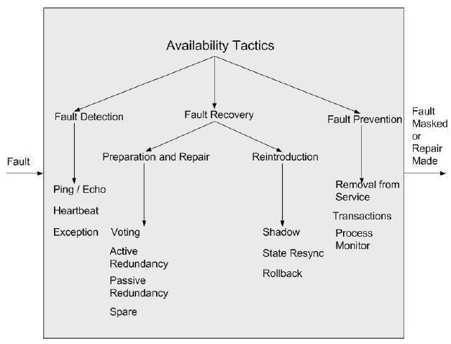
Summary of Availability Tactics

Slide 12
Modifiability Tactics
Goal is to control the time and cost to implement, test, and deploy changes.
Specific tactics include:
Localize modifications
Prevent ripple effects
Defer binding time
Localize Modifications
Maintain semantic coherence – making sure that all the responsibilities in a module are related and work together without excessive reliance on other modules.
Abstract common services – that way modifications may only need to be made once.
Anticipate expected changes – consider envisioned changes when doing decomposition.
Generalize the module – the more general the module is, the more likely changes can be accommodated with little or no change.
Limit possible options – for example limiting the platform for a product line could improve modifiability
Tactics
to Control
Modifiability
Changes Made,
Tested, and
Deployed Within
Time and Budget
Change
Arrives

Slide 13
Modifiability Tactics: Prevent Ripple Effects
There are several dependency types which causes ripple effects
Syntax (of data, of service), semantics (of data, of service), sequence (of data, of control), identity of interface, location of A, quality of service, existence of A, resource behavior of A
Tactics to prevent ripple effects include:
Hide information
Maintain existing interfaces - If B depends on the name and signature of an interface of A, maintaining this interface and its syntax allows B to remain unchanged.
Adding interfaces
Adding adapter
Providing a stub
Restrict communication paths

Slide 14
Modifiability Tactics: Prevent Ripple Effects…
Use an intermediary - If B has any type of dependency on A other than semantic, it is possible to insert an intermediary between B and A that manages activities associated with the dependency.
Data (syntax) – Repositories (both blackboard and passive) act as intermediaries between the producer and consumer of data
Service (syntax) – The facade, bridge, mediator, strategy, proxy, and factory patterns all provide intermediaries that convert the syntax of a service from one form into another.
Identity of an interface of A – A broker pattern can be used to mask changes in the identity of an interface.
Location of A (runtime) – A name server enables the location of A to be changed without affecting B.
Resource behavior of A or resource controlled by A – resource manager
Existence of A – The factory pattern has the ability to create instances as needed

Slide 15
Modifiability Tactics: Defer Binding Time
The two tactic categories we have discussed thus far are designed to minimize the number of modules that require changing to implement modifications.
Time to deploy and allowing non-developers to make changes are part of modifiability that could be achieved by the this category of tactics
Runtime registration - supports plug-and-play operation at the cost of additional overhead to manage the registration.
Configuration files are intended to set parameters at startup
Polymorphism allows late binding of method calls
Component replacement allows load time binding
Adherence to defined protocols allows runtime binding of independent processes

Slide 16
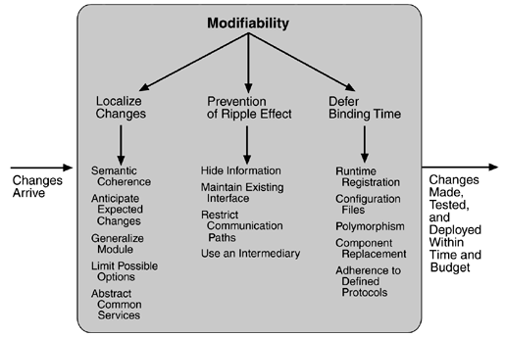
Summary of Modifiability Tactics

Slide 17
Performance Tactics
Goal is to generate a response to an event arriving at the system within some time constraint.
Two Basic Contributors to the Response Time
Resource Consumption – Resources include CPU, data stores, network communication bandwidth, and memory. Events go through a processing sequence which contributes to the overall latency of the response.
Blocked Time – There may be:
Contention for resources
Unavailability of resources
Dependency on other computation
Specific tactics include:
Resource Demand
Resource Management
Resource Arbitration
Tactics
to Control
Performance
Events
Arrive
Response Generated Within Time Constraints

Slide 18
Performance Tactics: Resource Demand
Event streams are the source of resource demand. Two characteristics of demand are
the time between events in a resource stream (how often a request is made in a stream) and
how much of a resource is consumed by each request.
Reduce the resources required for processing an event stream
Increase computational efficiency – improve algorithm efficiency or trade one resource for another
Reduce computational overhead – for example, eliminate intermediaries
Reduce the number of events processed
Manage event rate – reduce the frequency at which environmental variables are monitored
Control frequency of sampling –queued requests can be sampled at a lower frequency, possibly resulting in the loss of requests.
Other tactics for reducing or managing demand
Bound execution times – limit how much execution time is used to respond to an event
Bound queue sizes – controls the maximum number of queue arrivals

Slide 19
Performance Tactics: Resource Management
Introduce concurrency – blocked time can be reduced if requests can be processed in parallel.
Maintain multiple copies of either data or computations – clients in a client server pattern are replicas of the computation which reduces contention. Caching is a tactic in which data is replicated.
Increase available resources – add additional or faster processors, memory, or faster networks.
Performance Tactics: Resource Arbitration
Whenever there is contention for a resource, the resource must be scheduled.
A scheduling strategy has two parts, a priority assignment and dispatching.
Competing criteria for scheduling include:
Optimal resource usage, Request importance, Minimizing the number of resources used, Minimizing latency, Maximizing throughput, Preventing starvation to ensure fairness

Slide 20
Performance Tactics: Resource Arbitration
A high-priority event stream can be dispatched only if the resource to which it is assigned is available which may require pre-empting the current user.
Possible preemption options are as follows:
Can occur anytime
Can occur only at specific pre-emption points
Executing processes cannot be pre-empted
Common Scheduling strategies
First-in/first-out
Fixed-priority scheduling
Semantic importance- priority assigned according to some domain characteristic of the task that generates it
Deadline monotonic- higher priority assigned to streams with shorter deadlines
Rate monotonic - higher priority assigned to streams with shorter periods.
Dynamic priority scheduling (Round robin, Earliest deadline first)
Static scheduling - pre-emption points and the sequence of assignment to the resource are determined offline.

Slide 21
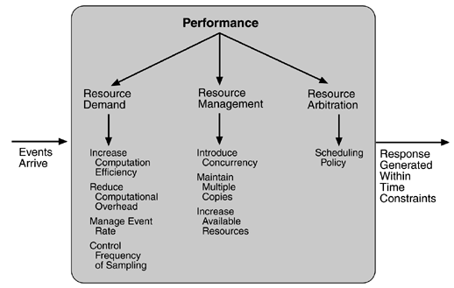
Summary of Performance Tactics

Slide 22
Security Tactics
Tactics for achieving security can be divided into those concerned with
Resisting attacks
Detecting attacks
Recovering from attacks
Analogy:
Putting a lock on your door is a form of resisting an attack,
Having a motion sensor inside of your house is a form of detecting an attack, and
Having insurance is a form of recovering from an attack.
Tactics
to Control
Security
System Detects, Resists, or Recovers from Attacks
Attack

Slide 23
Security Tactics: Resisting Attacks
Authenticate users – ensuring that a user or remote computer is actually who it purports to be (e.g., via passwords).
Authorize users – ensuring that an authenticated user has the rights to access and modify either data or services (e.g., via access control by user or user class within the system).
Maintain data confidentiality – data should be protected from unauthorized access (e.g., via encryption of persistent data or use of VPN or SSL for a Web-based link).
Maintain integrity – data should be delivered as intended (e.g., via use of redundant encoded information like checksums or hash results).
Limit exposure – allocate services to hosts so that limited services are available on each host.
Limit access – restrict access based on message source or destination port if possible (e.g., via firewalls)

Slide 24
Security Tactics: Detecting Attacks
The detection of an attack is usually done through an intrusion detection system.
Such systems work by comparing network traffic patterns to a database
For misuse detection
the traffic pattern is compared to known attack patterns.
For anomaly detection
the traffic pattern is compared to the historical baseline of itself.
Intrusion detectors must have some sort of :
Sensor to detect attacks
Managers to do sensor fusion
Databases for storing events for later analysis
Tools for offline reporting and analysis
A control console so that the analyst can modify intrusion detection actions.

Slide 25
Security Tactics: Recovering from Attacks
Tactics involved in recovering from an attack can be divided into
those concerned with restoring state and
those concerned with attacker identification (for either preventive or punitive purposes).
Tactics concerned with restoring state
These overlap with availability tactics - since they are both concerned with recovering a consistent state from an inconsistent state
Special attention is paid to maintaining redundant copies of system administrative data like passwords, access control lists, domain name services and user profile data.
Those concerned with attacker identification
Maintain an audit trail - an audit trail is a copy of each transaction applied to the data in the system together with identifying information.

Slide 26
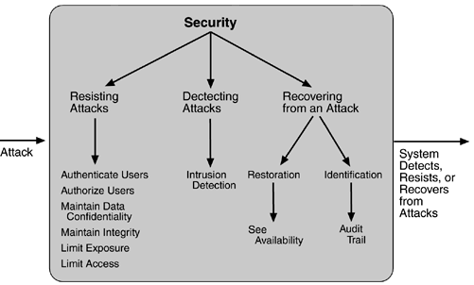
Summary of Security Tactics

Slide 27
Testability Tactics
The goal of a testing is to discover faults which requires that input be provided and that output be captured.
The goal of testability tactics is to allow for easier testing when an increment of software development is completed.
Two categories of tactics for testing are:
Providing input and capturing output
Internal monitoring
Tactics
to Control
Testability
Completion
of an
Increment
Faults
Detected

Slide 28
Testability Tactics…
Input /Output
Record/Playback – capturing information crossing an interface and using it as input into an automated test framework/ test harness.
Separate interface from implementation – allows substitution of implementations for various testing purposes
Specialize access routes/interfaces – Having specialized testing interfaces allows the capturing or specification of variable values for a component through a test harness as well as independently from its normal execution.
Internal Monitoring - A component can implement tactics based on internal state to support the testing process.
Built-in monitors
The component can maintain state, performance load, capacity, security, or other information accessible through an interface.
This interface can be a permanent interface of the component or it can be introduced temporarily via an instrumentation technique (e.g., aspect-oriented programming , via preprocessor macros, …)

Slide 29
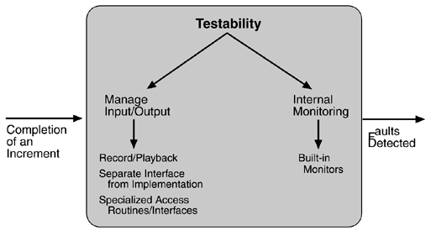
Summary of Testability Tactics

Slide 30
Usability Tactics
Usability is concerned with how easy it is for the user to accomplish a desired task and the kind of support the system provides.
Two categories of tactics are available
Runtime tactics
Design time tactics
Runtime tactics
Once a system is executing, usability is enhanced by giving the user feedback as to what the system is doing and by providing the user with the ability to issue usability-based commands. For example, cancel, undo, aggregate, and show multiple views support the user in either error correction or more efficient operations.
Tactics
to Control
Usability
User
Request
User Given
Appropriate
Feedback and
Assistance

Slide 31
Usability Tactics: Runtime tactics
Human-Computer Interaction Modes - describe which of the human–computer pair takes the initiative in performing certain actions and how the interaction proceeds.
User initiative – the user takes the initiative
System initiative – the system take the initiative
Mixed initiative – the user and the system working together initiate an action.
For Example, , when canceling a command the user issues a cancel—"user initiative"—and the system responds. During the cancel, however, the system may put up a progress indicator—"system initiative." Thus, cancel demonstrates "mixed initiative."
Support User Initiative
The architect must enumerate the responsibilities of the system to respond to the user command.
Examples of user initiated commands: Cancel , Undo, Aggregate, Show multiple views

Slide 32
Usability Tactics: Runtime tactics…
Support System Initiative - When the system takes the initiative, it must rely on some information – a model – about the user, the task being undertaken by the user, or the state of the system itself. Each model requires various types of input to accomplish its initiative.
Maintain a model of the task - The task model is used to determine context so the system can have some idea of what the user is attempting and provide various kinds of assistance. For example, knowing that sentences usually start with capital letters would allow an application to correct a lower-case letter in that position.
Maintain a model of the user – to determine users knowledge of the system and behavior. For example, maintaining a user model allows the system to pace scrolling so that pages do not fly past faster than they can be read.
Maintain a model of the system – to determine expected system behavior so that appropriate feedback can be given to the user.

Slide 33
Usability Tactics: Design-Time Tactics
These are refinements of modifiability tactics to aid in making revisions to the user interface design, for example:
Separate the user interface from the rest of the application
Since the user interface is expected to change frequently both during the development and after deployment, maintaining the user interface code separately will localize change in it (localizing expected changes is the rationale for semantic coherence).
The software architecture patterns developed to implement this tactic and to support the modification of the user interface are:
Model-View-Controller
Presentation-Abstraction-Control
Seeheim
Arch/Slinky

Slide 34
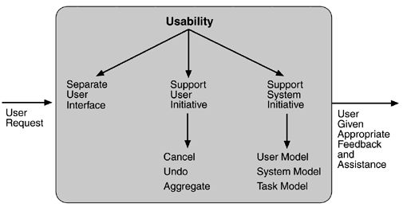
Usability Tactics

Slide 35
Relationship of Tactics to Architectural Patterns
An architect usually chooses a pattern or a collection of patterns designed to realize one or more tactics - Architectural patterns implements multiple tactics
For example, the active object design pattern, which decouples method execution from method invocation to enhance concurrency and simplify synchronized access to objects that reside in their own thread of control, uses several tactics.
The pattern consists of six elements:
A proxy – which provides an interface that allows clients to invoke publicly accessible methods on an active object.
A method request – which defines an interface for executing the methods of an active object.
An activation list – which maintains a buffer of pending method requests.
A scheduler – which decides what method requests to execute next.
A servant – which defines the behavior and state modeled as an active object.
A future – which allows the client to obtain the result of the method invocation.

Slide 36
Relationship of Tactics to Architectural Pattern…
The motivation of this pattern is to enhance concurrency – a performance goal.
It’s main purpose is therefore to implement the “introduce concurrency” performance tactic.
This pattern however involves several other patterns:
Information hiding (modifiability) – each element chooses the responsibilities it will achieve and hides their achievement behind an interface.
Intermediary (modifiability) – The proxy acts as an intermediary.
Binding time (modifiability) – The active object pattern assumes that the requests for the object arrive at the object at runtime, but the binding time of the client to the proxy is left open.
Scheduling policy (performance) – the scheduler implements some scheduling policy.
Any pattern implements several tactics, often concerned with different quality attributes, and any implementation of the pattern also makes choices about tactics.

Slide 37
Text Book Website http://etutorials.org/Programming/Software+architecture+in+practice,+second+edition/

