Slide 1

BahirDar University
Institute of Technology
School of Computing And Electrical Engineering
Computer Science and Engineering Department (Hardware Stream)
Artificial Neural Network Course
Assignment Presentation

Slide 2
Presentation Out line
Support Vector Machine
  Definition
  Motivation
  Advantage
  Architecture
  Algorithm
  Kernel function
  Application
  Draw back

Slide 3
Presentation Out line
Radial Basis Function
  Definition
  Motivation
  Advantage
  Architecture
  Algorithm
  Application
  Draw back

Slide 4
Support Vector Machine Definition, Motivation, and Advantage
Presented by: Elizabeth Bahita

Slide 5
Support Vector Machines
What is SVM?
A support vector machine (SVM) is a concept that for a set of related supervised learning methods that analyze data and recognize patterns.
The standard SVM takes a set of input data and predicts, for each given input, which of two possible classes the input is a member of, which makes the SVM a non-probabilistic binary linear classifier.

Slide 6
Definition Cont…
Over the last few years, the SVM has been established as one of the preferred approaches to many problems in pattern recognition and regression estimation.
The main idea of support vector classification is to separate examples with a linear decision surface and maximize the margin between the different classes.

Slide 7
Motivation
The main idea of support vector classification is to separate examples with a linear decision surface and maximize the margin between the different classes.
Suppose some given data points each belong to one of two classes, and the goal is to decide which class a new data point will be in.

Slide 8
Separating data with a plane

Slide 9
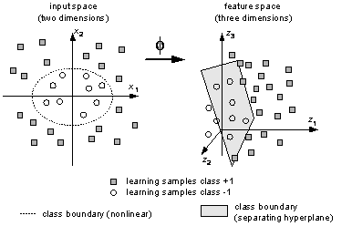
What can be done with data for which no linear separation exists?
Mapping the data to higher-dimensional space where a linear separation is possible.
Using an appropriate mapping function we could map these data from two dimension to three dimension.

Slide 10
Advantages of SVM
Solves classification and regression problems.
Efficiently computes (estimates) error rate and precision.
Includes algorithm for approximately training large data.
Handles many thousands of support vectors.
Handles several hundred-thousands of training examples

Slide 11
Supports standard kernel functions and lets you define your own.
The solution to an SVM is global and unique.
Unlike ANNs, the computational complexity of SVM does not depend on the dimensionality of the input space. ANN use empirical risk minimization, while SVM use structural risk minimization.
The reason that SVMs often outperform ANNs in practice is that they deal with the biggest problem with ANNs, SVMs are less prone to overfitting.

Slide 12
Support Vector Machine Architecture and Algorithm
Presented by: Bekele Haile Nassa

Slide 13
SVM architecture and algorithm
What is support vector machine(SVM)?
What is support vector?
What is the kernel trick is? ( why it use in SVM?)
What is margin? And its formulation?
What is optimal linear classifier hyper plane? And its formation?
What is the algorithm of SVM?

Slide 14
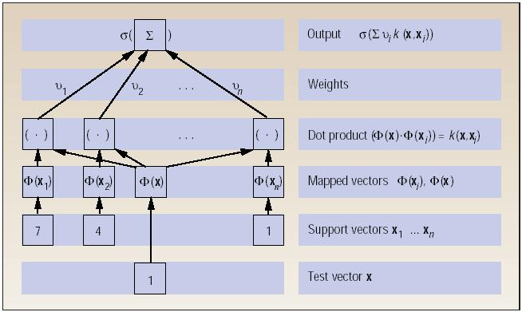
Architecture of SVM: non linear classifier

Slide 15
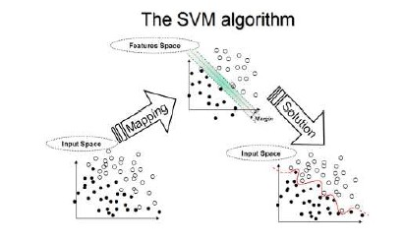
Algorithm of SVM

Slide 16
Choose a kernel function
A kernel function is defined as a function that corresponds to a dot product of two feature vectors in some expanded feature space:
Choose a value for C
Parameter C can be viewed as a way to control over fitting. Over fitting mean model is appropriate for training but not for testing

Slide 17
Choose a kernel function Cont…
Solve the quadratic programming problem
Construct the discriminant function from the support vectors
Fact:the data points can be represented in N-dimensional space, and a (N-1)-dimensional hyper plane can separate them.

Slide 18
Linear SVM’s: The Primal Form
minimize 1/2 *||w||2
subject to yi(w.xi + w0) ≥ 1 for i= 1, . . . ,m
Linear SVMs: The Dual Form
maximize ∑i=1ai-1/2 ∑i=1 ∑j=1aiajyiyj xi.xj
Up to M
subject to ∑ yiai = 0 , ai ≥ 0, i = 1, . . . ,m

Slide 19
Linear SVMs :with Soft Margin
Purpose: to allow for a small number of missclassified points,for better generalisation or computational efficiency.
introducing m non-negative(“slack”) variables Ei, for i = 1, . . . ,m such that:-
yi(w ・ xi + w0) ≥ 1 − Ei, for i = 1, . . . ,m

Slide 20
Generalized OSH
Minimize ½*||w||^2 + C∑i=1Ei
subject to yi(w .xi +w0) ≥ 1 −Ei for i = 1, . . . ,m
Ei≥ 0 for i = 1, . . . ,m
The associated dual form:
maximize ∑i=1ai-1/2 ∑i=1 ∑j=1aiajyiyj xi.xj
Up to M

Slide 21
Generalized OSH Cont…
subject to ∑ yiai = 0 , ai ≥ 0, i = 1, . . . ,m
0 ≤ i ≤ C, ai = 1, . . . ,m
The role of C:
it acts as a regularizing parameter.
large C ⇒ minimize the number of misclassified points
small C ⇒ maximize the minimum distance 1/||w||.

Slide 22
Non-Linear SVMs
We map the data points from the input space R^d into some space of higher dimension R^n (n > d) using a function : R^d → R^n
Then the training algorithm would depend only on dot products of
the form (xi).(xj).

Slide 23
Kernel Functions
Important remark: By the use of the kernel function, it is possible to compute the separating hyperplane without explicitly carrying out the map into the higher space.
If there were a “kernel function” K such that K(xi, xj) =Φ(xi). Φ(xj), we would only use K in the training algorithm.

Slide 24
Classes of Kernel Functions
Polynomial: K(x, x′) = (x ・ x′ + c)^q
RBF (radial basis function):
K(x, x′) =exp(−(||x−x′||^2)/2*δ^2)
Sigmoide: K(x, x′) = tanh(x .x′ − b)
Advantage: the only parameters when training an SVM are the kernel function K, and the “tradeoff” parameter C.

Slide 25
Kernel function and Application and Drawback of Support Vector Machine
Presented by: Habtamu worku

Slide 26
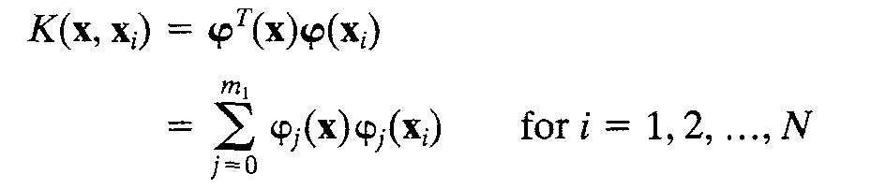
Kernel function
A kernel function is defined as a function that corresponds to a dot product of two feature vectors in some expanded feature space:
φ _{j}( x1) is defined a priori for all j.
Generally it is a set of nonlinear transformations from the input space to the feature sace:m1 is the dimension of feature space.

Slide 27
Kernel function cont…
From the above definition we immediately see that the inner-product kernel is symmetric function of its arguments, as shown by
K(x,x_{i}) = K(x_{i},x)
Kernels are functions that return inner products between the images of data points in some space.
By replacing inner products with kernels in linear algorithms, we obtain very flexible representations.

Slide 28
Kernel function cont…
Choosing K is equivalent to choosing φ (the embedding map)
Kernels can often be computed efficiently even for very high dimensional spaces.
Examples of commonly-used kernel functions:
  Linear kernel:
  Polynomial kernel:
  Gaussian (Radial-Basis Function (RBF) ) kernel:
  Sigmoid:

Slide 29
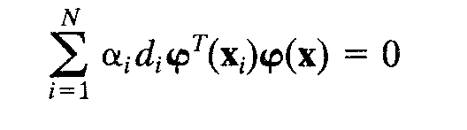
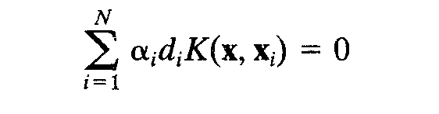
Kernel function cont…
Most importantly, we may use the inner product kernel K(x,x_{i}) = K(x_{i},x) to construct the optimal hyperplane in the feature space without having to consider the feature space itself in explicit form.
The decision surface computed in the feature space(optimal hyperplane) as:

Slide 30
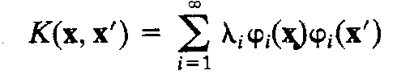
Kernel function cont…
Mercer’s Theorem
The expansion of inner-product kernel K(x,x_{i}) is an important special case of Mercer’s theorem that arises in functional analysis.
Let K(x,x’) be a continuous symmetric kernel that is defined in the closed interval a<= x <=b and likewise for x’. The kernel K(x,x’) can be expanded in the series

Slide 31
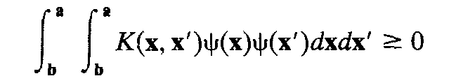
Kernel function cont…
With the positive coefficient λ_{i}>0 for all i.
For this expansion to be valid and for it to converge absolutely and uniformly, it is necessary and sufficient that the condition
The function φ(x) are called eigenfunctions of the expansion
The number λ_{i} are called eigenvalues.

Slide 32
Kernel function cont…
Mercer’s theorem only tells us whether or not a candidate kernel is actually an inner-product kernel in some space and therefore admissible for use in a support vector machine. But, it says nothing about how to construct the function φ(x); we have to do that ourselves.

Slide 33
Application of SVM
SVM has been used successfully in many real-world problems
- Text (and hypertext) categorization
- Image classification
- Bioinformatics (Protein classification,
Cancer classification)
- Hand-written character recognition

Slide 34
Application of SVM cont…
Text Categorization
Task: The classification of natural text (or hypertext) documents into a fixed number of predefined categories based on their content.
- email filtering, web searching, sorting documents by topic, etc..
A document can be assigned to more than one category, so this can be viewed as a series of binary classification problems, one for each category

Slide 35

Application of SVM cont…
Text Categorization cont…
A doc is represented by a vector indexed by a pre-fixed set or dictionary of terms
Values of an entry can be binary or weights
Normalization, stop words, word stems
Doc x => φ(x)

Slide 36
Application of SVM cont…
Texture Classification
Sathishkumar is currently doing M.Tech in computer vision and image processing in Amrita institute of technology (amrita vishwa vidya peetham)coimbatore, Tamilnadu, India. He received his B.E from bharathiar university in the year 2003. His intrests are Soft computing & Data mining techniques for image processing

Slide 37
Application of SVM cont…
E-learning
Personalized and learner centered learning is receiving increasing importance due to increased learning rate.
SVMs stand out due to their better performance specially in handling large dimensions which text content do possess. Lecture material could be reprocessed to create a suitable feature space and then present the contents to the learner as per his need. This will save time and also avoid information overload.

Slide 38
Application of SVM cont…
  Cancer classification
Support vector machine classification and validation of cancer tissue samples using microarray expression data.
DNA microarray experiments generating thousands of gene expression measurements are being used to gather information from tissue and cell samples regarding gene expression differences that will be useful in diagnosing disease. We have developed a new method to analyze this kind of data using support vector machines (SVMs). This analysis consists of both classification of the tissue samples, and an exploration of the data for mislabeled or questionable tissue results.

Slide 39
Drawback of SVM
In terms of running time, support vector machines are currently slower than other neural networks (e.g., multilayer perceptrons trained with the back-propagation algorithm) for a similar generalization performance.
If the number of features is much greater than the number of samples, the method is likely to give poor performances.

Slide 40
Drawback of SVM cont…
SVMs do not directly provide probability estimates, so these must be calculated using indirect techniques. In our case, these techniques imply conducting five-fold cross-validation, so performance can suffer.

Slide 41
Drawback of SVM cont…
It is sensitive to noise
- A relatively small number of mislabeled examples can dramatically decrease the performance
It only considers two classes
how to do multi-class classification with SVM?
    Answer:
    with output parity m, learn m SVM’s
    SVM 1 learns “Output==1” vs “Output != 1”
    SVM 2 learns “Output==2” vs “Output != 2”
    :
    SVM m learns “Output==m” vs “Output != m”
    3) To predict the output for a new input, just predict with each SVM and find out which one puts the prediction the furthest into the positive region.

Slide 42
RADIAL BASIS FUNCTION NETWORKS
Presented by:
Dawit Abrha

Slide 43
Radial Basis Function Network(RBF)
What is radial basis function?
  Radial: Symmetric around its center
  Basis Functions: Also called kernels, a set of functions whose linear combination can generate an arbitrary function in a given function space.
A function is radial basis (RBF) if its output depends on (is a non-increasing function of) the distance of the input from a given stored vector.

Slide 44
Radial Functions
Characteristic feature-their response decreases (or increases) monotonically with distance from a central point.
The center, the distance scale, and the precise shape of the radial function
are parameters of the model, all fixed if it is linear.
Typical radial functions are:
  The Gaussian RBF (monotonically decreases with distance from the center).
  A multiquadric RBF (monotonically increases with distance from the center).

Slide 45
Radial Basis Function Network(RBF)
A Radial Basis Function like Gaussian Kernel is applied as an activation function.
A Radial Basis Function(also called Kernel Function) is a real-valued function whose value depends only on the distance from the origin or any other center: F(x)=F(|x|)
RBF network uses a hybrid learning , unsupervised clustering algorithm and a supervised least square algorithm

Slide 46
RBF Network
As a comparison to multilayer perceptron Net.:
-The Learning algorithm is faster than back-propagation
- After training the running time is much more slower
This is becoming an increasingly popular neural network with diverse applications and is probably the main rival to the multi-layered perceptron
Much of the inspiration for RBF networks has come from traditional statistical pattern classification techniques

Slide 47
RBF Motivations
When Input rather than target is noisy
There is a basis function centered on every data point
For better performance than Sigmoid function
- Some classification problems
- Function interpolation
- Much of the inspiration for RBF networks has come from traditional statistical pattern classification techniques

Slide 48
RBF Network
The basic architecture for a RBF is a 3-layer network, as shown in Fig.
The input layer is simply a fan-out layer and does no processing.
The second or hidden layer performs a non-linear mapping from the input space into a (usually) higher dimensional space in which the patterns become linearly separable.

Slide 49
architecture

Slide 50
RBF Architecture
x₁
h₁
W₁
h₂
x₂
W₂
h₃
x₃
W₃
f(x)
W_{m}
x_{n}
h_{m}
Input layer
Hidden layer
Output layer

Slide 51
Radial basis function
architecture
m
f(x) = ∑ w_{j}h_{j}(x)
j=1
h_{j}(x) = exp( -(x-c_{j})² / r_{j}² )
Where c_{j} is center of a region,
r_{j} is width of the receptive field

Slide 52
Output layer
architecture
The final layer performs a simple weighted sum with a linear output.
If the RBF network is used for function approximation (matching a real number) then this output is fine.
However, if pattern classification is required, then a hard-limiter or sigmoid function could be placed on the output neurons to give 0/1 output values.

Slide 53
Clustering
architecture
The unique feature of the RBF network is the process performed in the hidden layer.
The idea is that the patterns in the input space form clusters.
If the centres of these clusters are known, then the distance from the cluster centre can be measured.
Furthermore, this distance measure is made non-linear, so that if a pattern is in an area that is close to a cluster centre it gives a value close to 1.

Slide 54
Clustering
architecture
Beyond this area, the value drops dramatically.
The notion is that this area is radially symmetrical around the cluster centre, so that the non-linear function becomes known as the radial-basis function.

Slide 55
+ve points of RBF over MLP
Advantages of RBF networks:
  They can model any nonlinear function using a single hidden layer.
  The simple linear transformation in the output layer can be optimized fully using traditional linear modeling techniques.
    Avoids local minima
  Faster training
Notes:
RBF can model any nonlinear function using a single hidden layer, which removes some design-decisions about numbers of layers.
The simple linear transformation in the output layer can be optimized fully using traditional linear modeling techniques, which are fast and do not suffer from problems such as local minima which plague MLP training techniques. RBF networks can therefore be trained extremely quickly (i.e., orders of magnitude faster than MLPs).
Dis of RBF:
On the other hand, before linear optimization can be applied to the output layer of an RBF network, the number of radial units must be decided, and then their centers and deviations must be set. Although faster than MLP training, the algorithms to do this are equally prone to discover sub-optimal combinations. Other features that distinguish RBF performance from MLPs are due to the differing approaches to modeling space, with RBFs "clumpy" and MLPs "planey."
The clumpy approach also implies that RBFs are not inclined to extrapolate beyond known data: the response drops off rapidly towards zero if data points far from the training data are used. Often the RBF output layer optimization will have set a bias level, hopefully more or less equal to the mean output level, so in fact the extrapolated output is the observed mean - a reasonable working assumption. In contrast, an MLP becomes more certain in its response when far-flung data is used. Whether this is an advantage or disadvantage depends largely on the application, but on the whole the MLP's uncritical extrapolation is regarded as a bad point: extrapolation far from training data is usually dangerous and unjustified.
RBFs are also more sensitive to the curse of dimensionality, and have greater difficulties if the number of input units is large: this problem is discussed further in a later section.
However, RBFs as described above suffer similar problems to Multilayer Perceptrons if they are used for classification - the output of the network is a measure of distance from a decision hyperplane, rather than a probabilistic confidence level. We may therefore choose to modify the RBF by including an output layer with logistic or softmax (normalized exponential) outputs, which is capable of probability estimation. We lose the advantage of fast linear optimization of the output layer; however, the non-linear output layer still has a relatively well-behaved error surface, and can be optimized quite quickly using a fast iterative algorithm such as conjugate gradient descent.

Slide 56
–ve points of RBF over MLP
Disadvantages of RBF Networks:
  Prone to discover sub-optimal combinations
  Large Dimensions
  May require large number of radial units
  Slower execution
  Inability to extrapolate data… Limitation or Advantage in disguise???
Notes:
RBF can model any nonlinear function using a single hidden layer, which removes some design-decisions about numbers of layers.
The simple linear transformation in the output layer can be optimized fully using traditional linear modeling techniques, which are fast and do not suffer from problems such as local minima which plague MLP training techniques. RBF networks can therefore be trained extremely quickly (i.e., orders of magnitude faster than MLPs).
Dis of RBF:
On the other hand, before linear optimization can be applied to the output layer of an RBF network, the number of radial units must be decided, and then their centers and deviations must be set. Although faster than MLP training, the algorithms to do this are equally prone to discover sub-optimal combinations. Other features that distinguish RBF performance from MLPs are due to the differing approaches to modeling space, with RBFs "clumpy" and MLPs "planey."
The clumpy approach also implies that RBFs are not inclined to extrapolate beyond known data: the response drops off rapidly towards zero if data points far from the training data are used. Often the RBF output layer optimization will have set a bias level, hopefully more or less equal to the mean output level, so in fact the extrapolated output is the observed mean - a reasonable working assumption. In contrast, an MLP becomes more certain in its response when far-flung data is used. Whether this is an advantage or disadvantage depends largely on the application, but on the whole the MLP's uncritical extrapolation is regarded as a bad point: extrapolation far from training data is usually dangerous and unjustified.
RBFs are also more sensitive to the curse of dimensionality, and have greater difficulties if the number of input units is large: this problem is discussed further in a later section.
However, RBFs as described above suffer similar problems to Multilayer Perceptrons if they are used for classification - the output of the network is a measure of distance from a decision hyperplane, rather than a probabilistic confidence level. We may therefore choose to modify the RBF by including an output layer with logistic or softmax (normalized exponential) outputs, which is capable of probability estimation. We lose the advantage of fast linear optimization of the output layer; however, the non-linear output layer still has a relatively well-behaved error surface, and can be optimized quite quickly using a fast iterative algorithm such as conjugate gradient descent.

Slide 57
MLPs versus RBFs
Classification
  MLPs separate classes via hyperplanes
  RBFs separate classes via hyperspheres
Learning
  MLPs use distributed learning
  RBFs use localized learning
  RBFs train faster
Structure
  MLPs have one or more hidden layers
  RBFs have only one layer
  RBFs require more hidden neurons => curse of dimensionality
X₂
MLP
X₁
X₂
RBF
X₁

Slide 58
Advantages/Disadvantages
RBF trains faster than a MLP
Another advantage that is claimed is that the hidden layer is easier to interpret than the hidden layer in an MLP.
Although the RBF is quick to train, when training is finished and it is being used it is slower than a MLP, so where speed is a factor a MLP may be more appropriate.

Slide 59
Algorithm, Application and Drawback of Radial Base Function
Persented by: Awel Abdo

Slide 60
Learning algorithm for RBF
Given the number of the hidden nodes (centers) J is chosen, the learning algorithm is formulated as follows:
Find the positions of centers {w_{j}}. This can be done by the following procedure:
Choose randomly J instances x_{j} and use them as the positions of the centers {w_{j}}
All the remainder of the instances (training patterns) is assigned to a class j of the closest centre w_{j}, and the locations of each center are calculated again using for example k-nearest neighbor method.
The above steps are repeated until the locations of the centers stop changing.

Slide 61
Learning algorithm for RBF Cont…
II. Calculate the output from each hidden neuron as a function of a radial distance from the input vector to the radial center. Calculated distance between the center and the input vector is passed through a non-linear mapping Gaussian function.

Slide 62
Learning algorithm for RBF Cont…
III. Weights {b_{jk}} for the output layer are calculated using methodologies as in MLP, using back propagation.
Where b_{jk} – the weight on the connection from the hidden node j to the output node k, y_{j} - the output from the hidden node j

Slide 63
Learning algorithm for RBF Cont…
IV. Calculate the error between the network’s output and the target output and if the error of the network’s output is more than the desired limit then the number of the hidden units are changed and all the steps are repeated again.

Slide 64
  Applications of RBF
finite element or spectral methods for the solution of partial differential equations
neural networks with radial basis functions, and machine learning
approximations on spheres
statistical approximations, where positive definite kernels are very important
geophysical research
and many engineering applications
Reconstruction and Representation of 3D Objects with Radial Basis Functions

Slide 65
Applications of RBF
Surface Interpolation with Radial Basis Functions for Medical Imaging
Smooth surface reconstruction from noisy range data
Speech recognition
Image processing
Time-series analysis
Adaptive equalization
Radar point source location
Medical diagnosis
Process faults detection
Pattern recognition

Slide 66
Thank you !!

